Slide 1
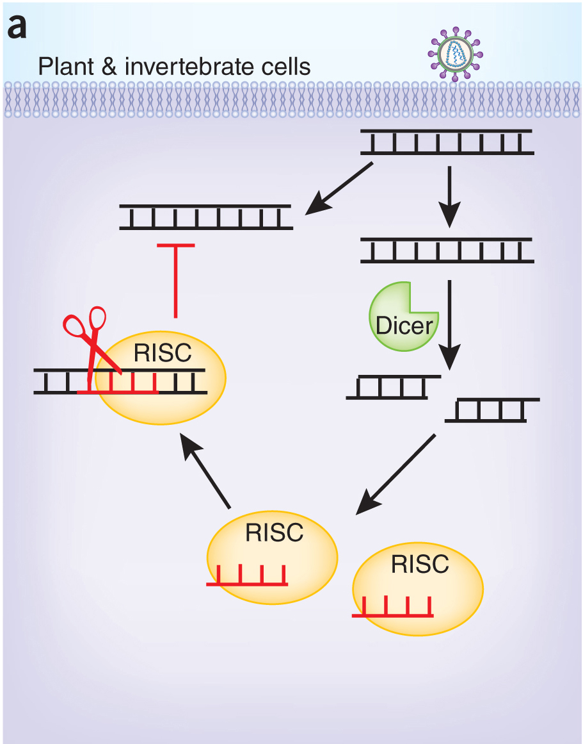
RNA-Based Immunity

Slide 2
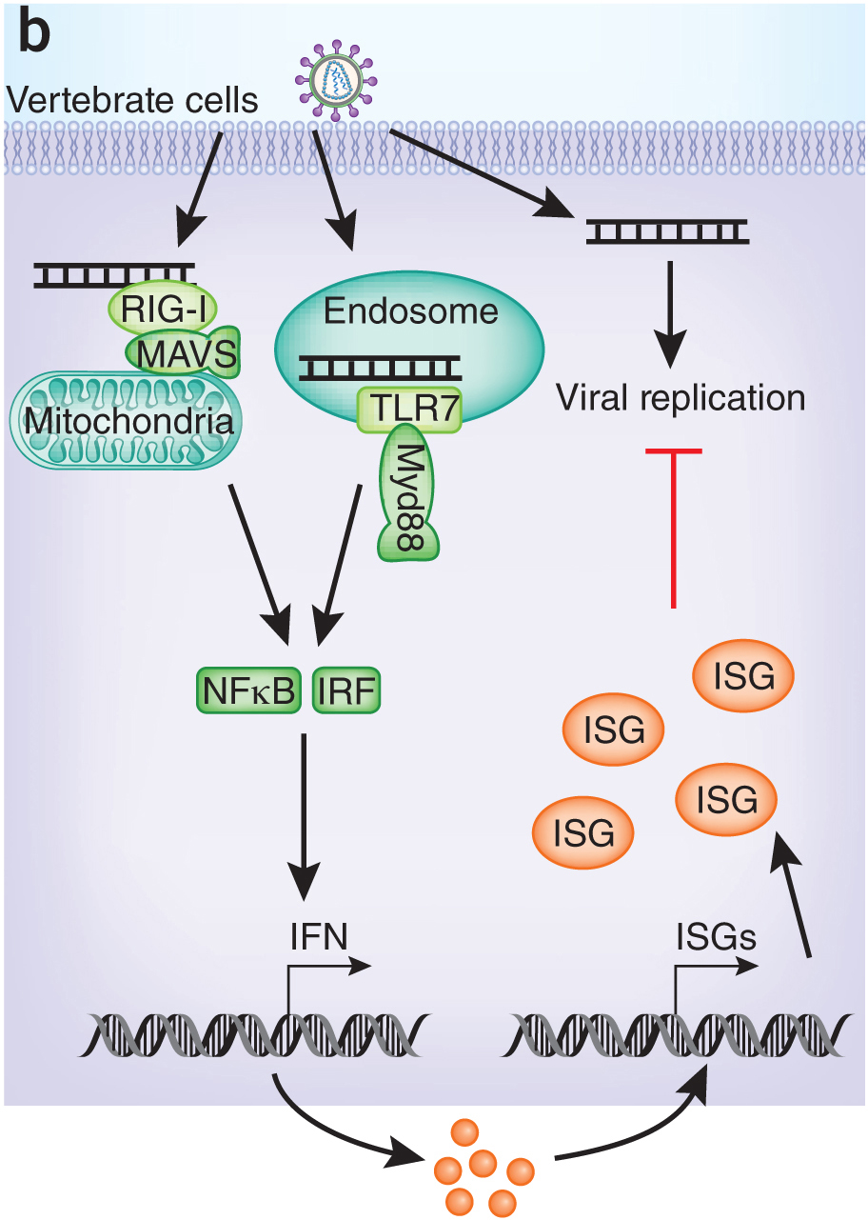
Protein-Based Immunity to Viruses

Slide 3
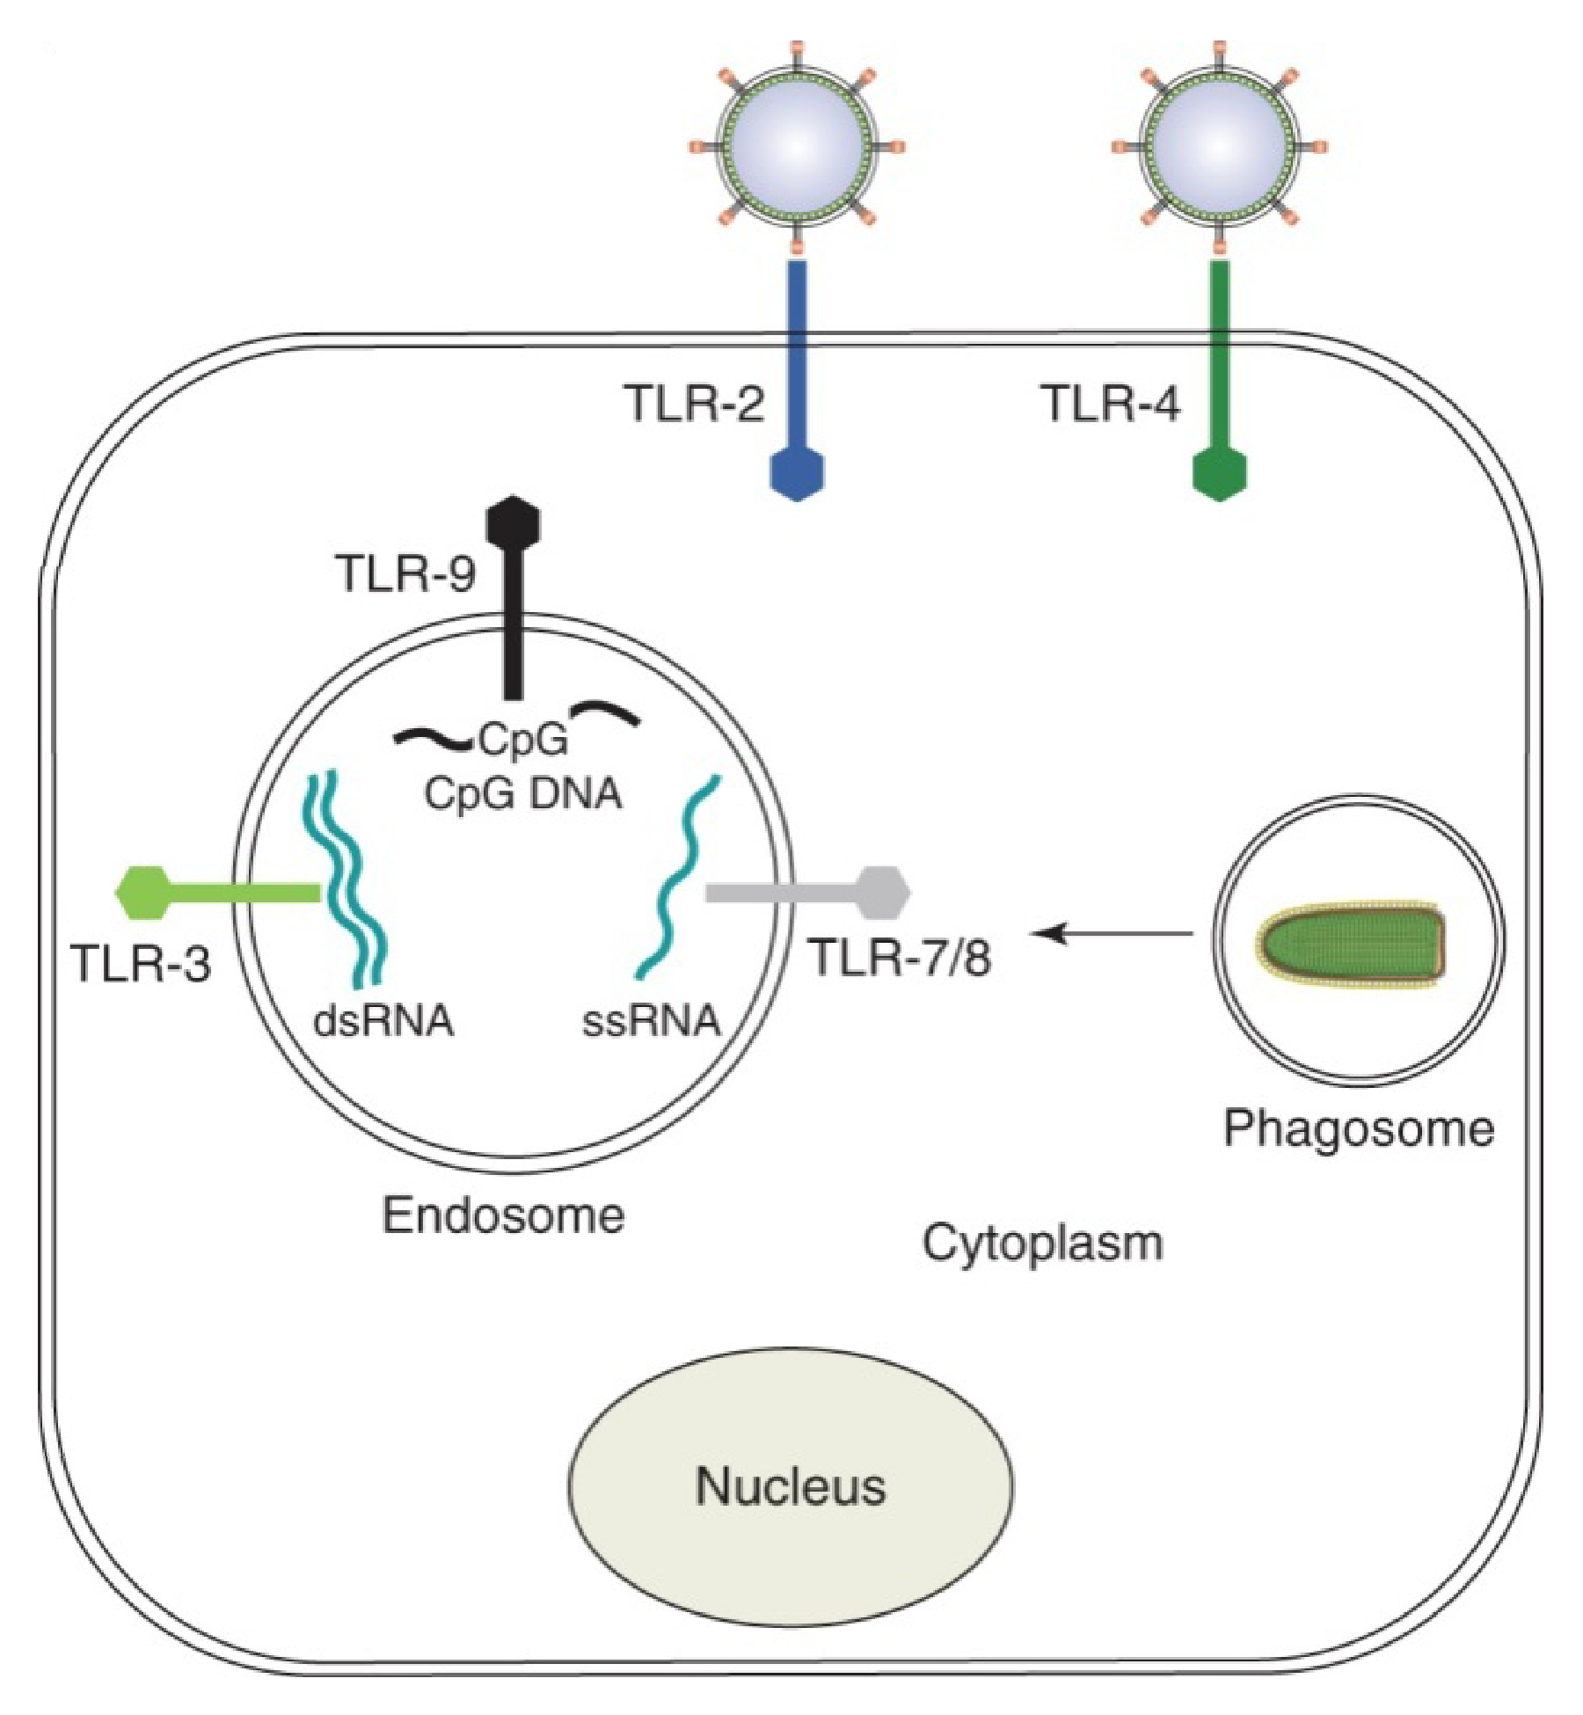
Detection of Virus Infection by TLRs

Slide 4
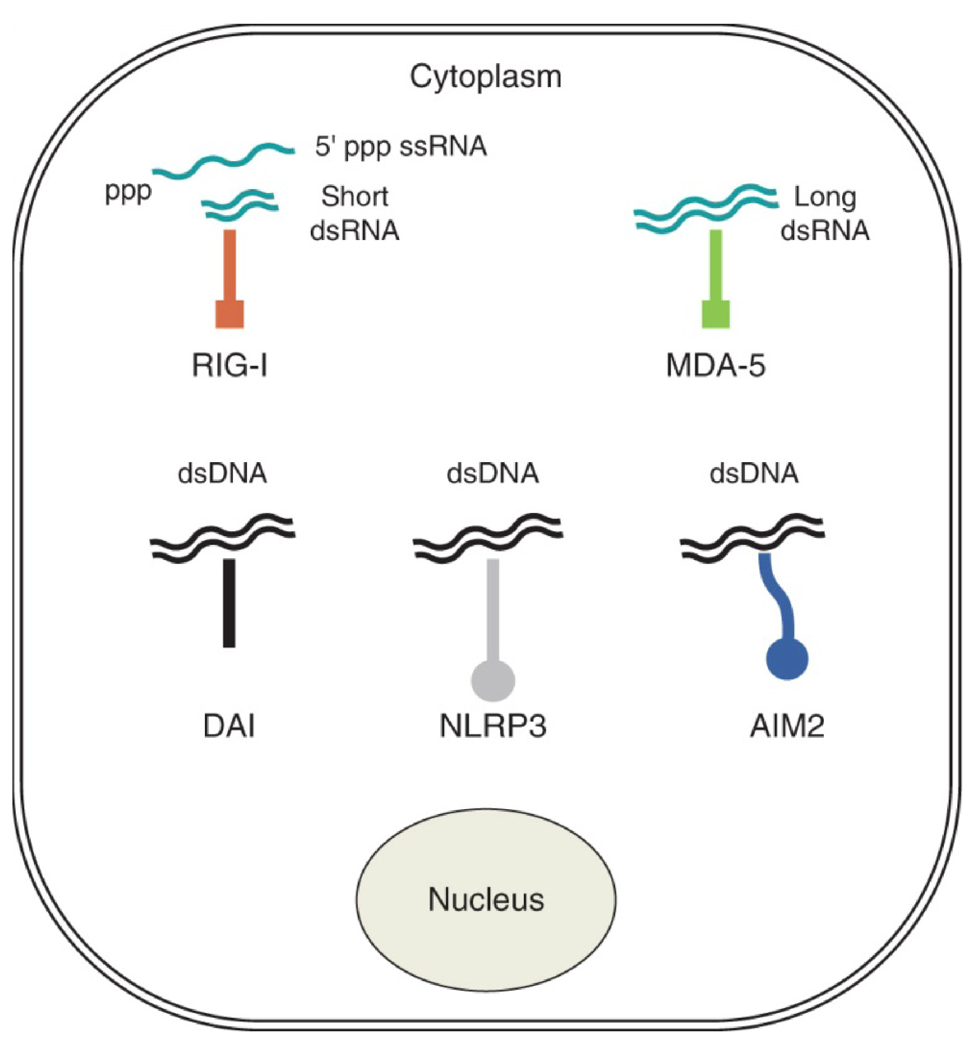
Detection of Virus Infection by Cytosolic Receptors

Slide 5
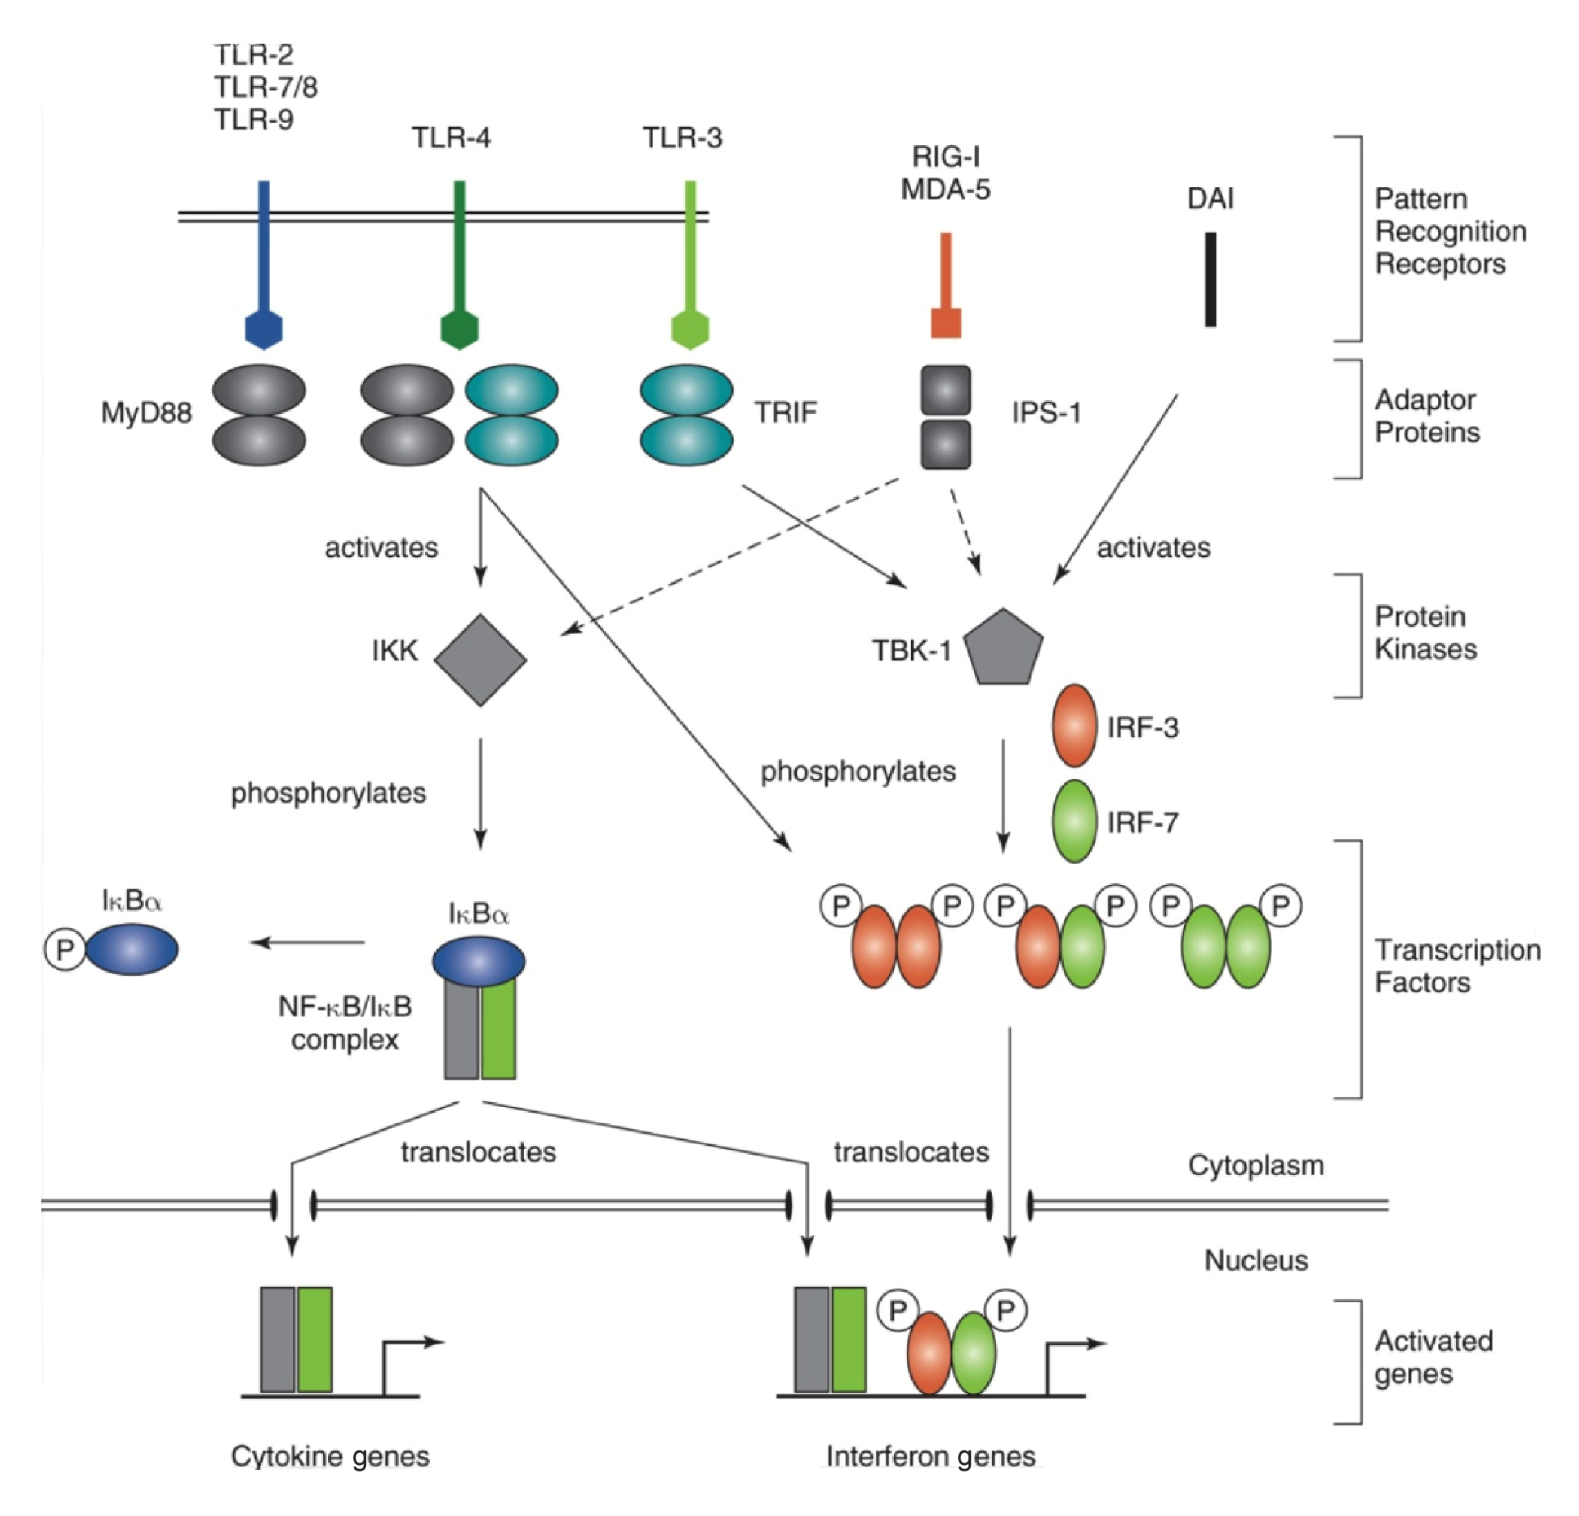
Host Cell Response to Viral Infection

Slide 6
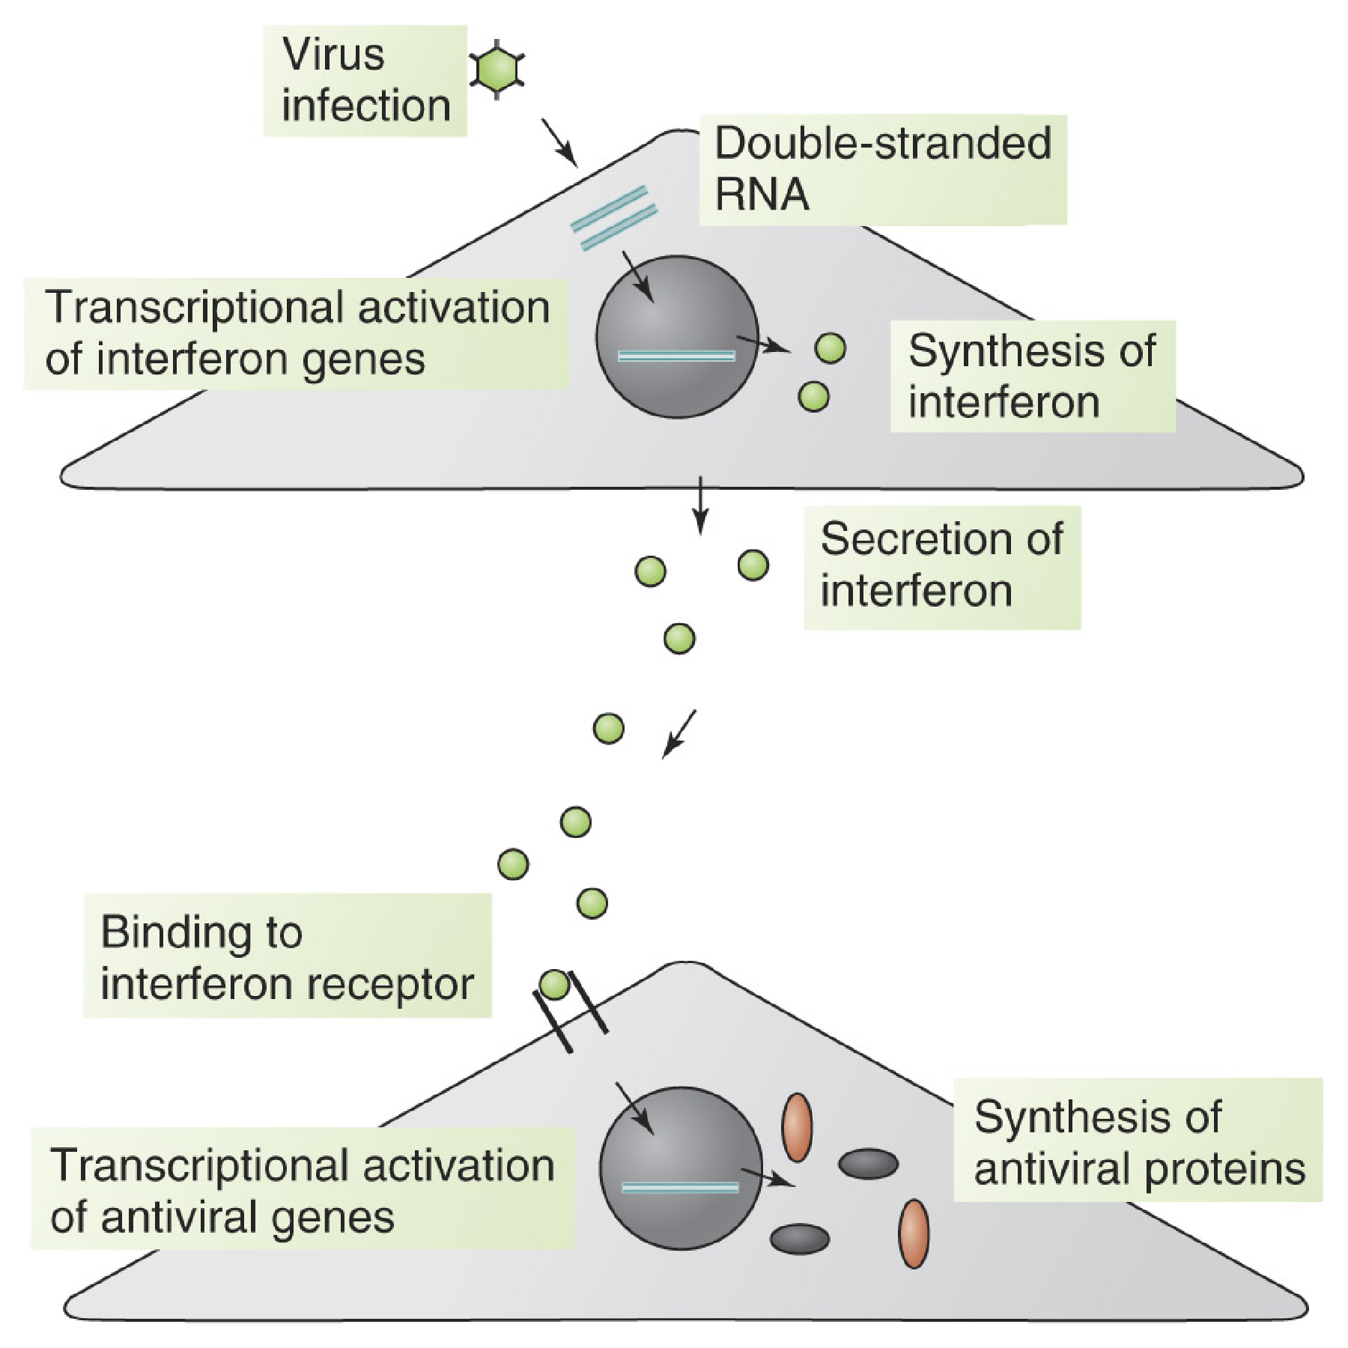
Interferons Act on Adjacent Cells

Slide 7
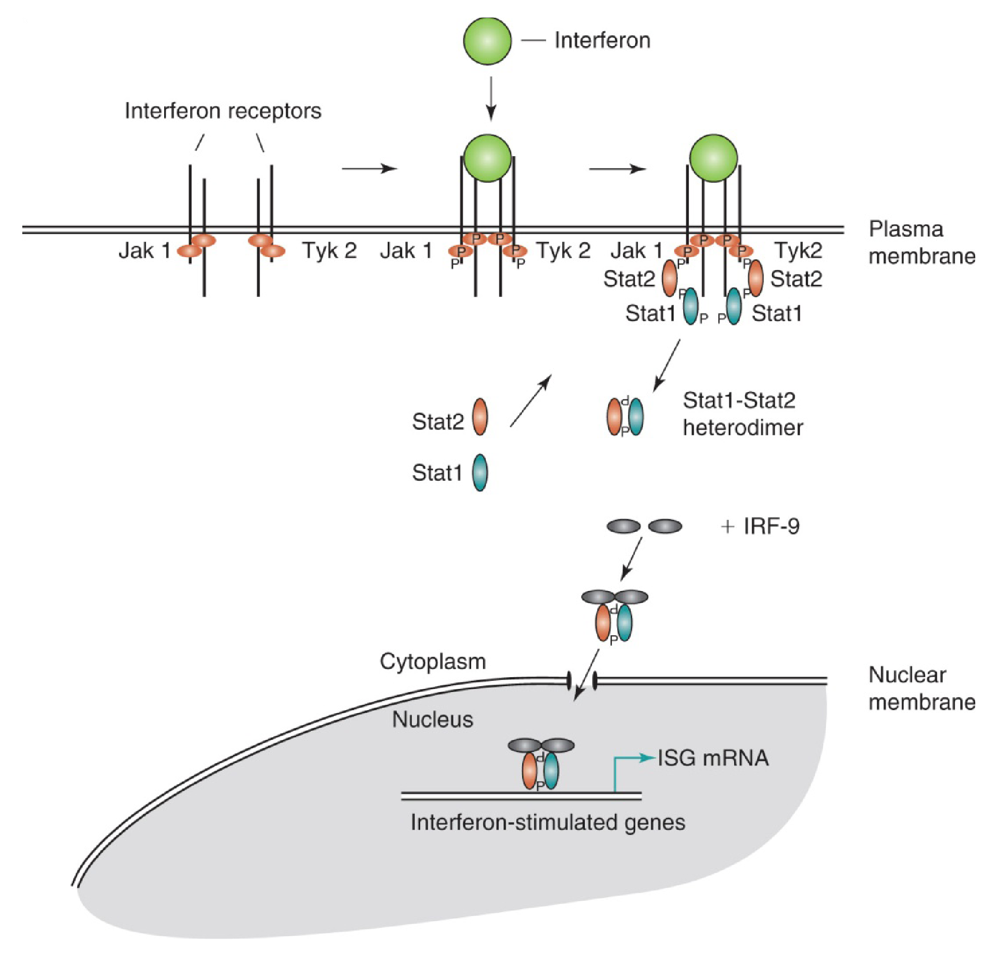
Signal Transduction by Interferons

Slide 8
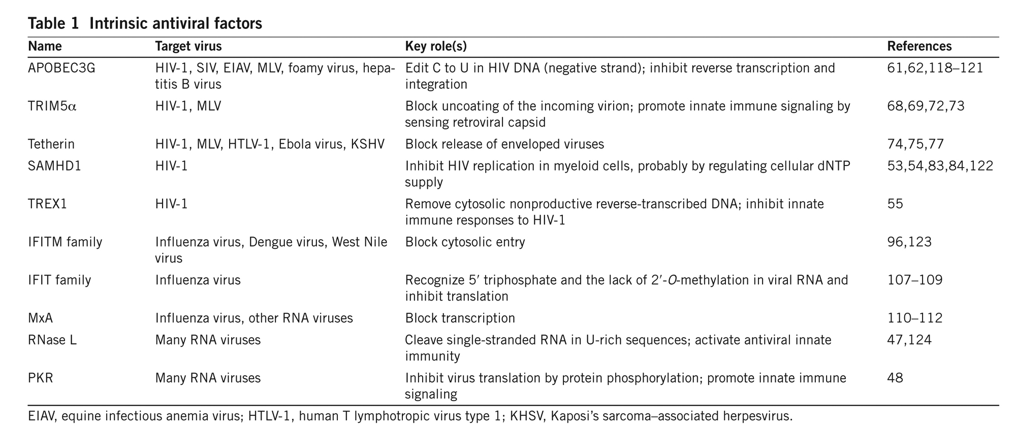
Intrinsic Antiviral Factors

Slide 9
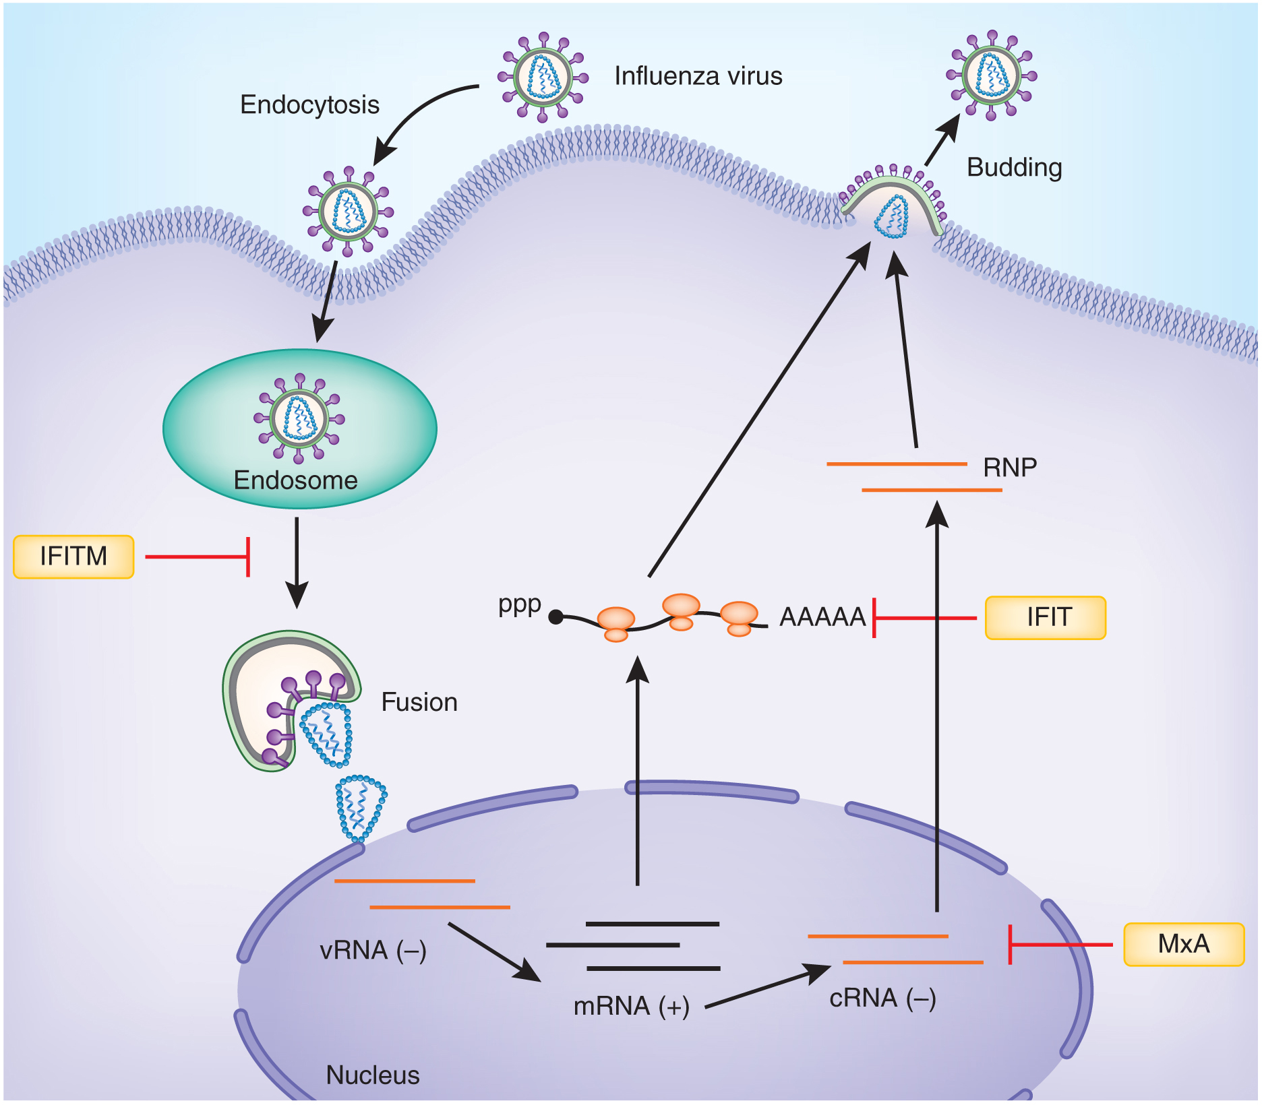
Intrinsic Antiviral Factors Against Influenza Virus

Slide 10
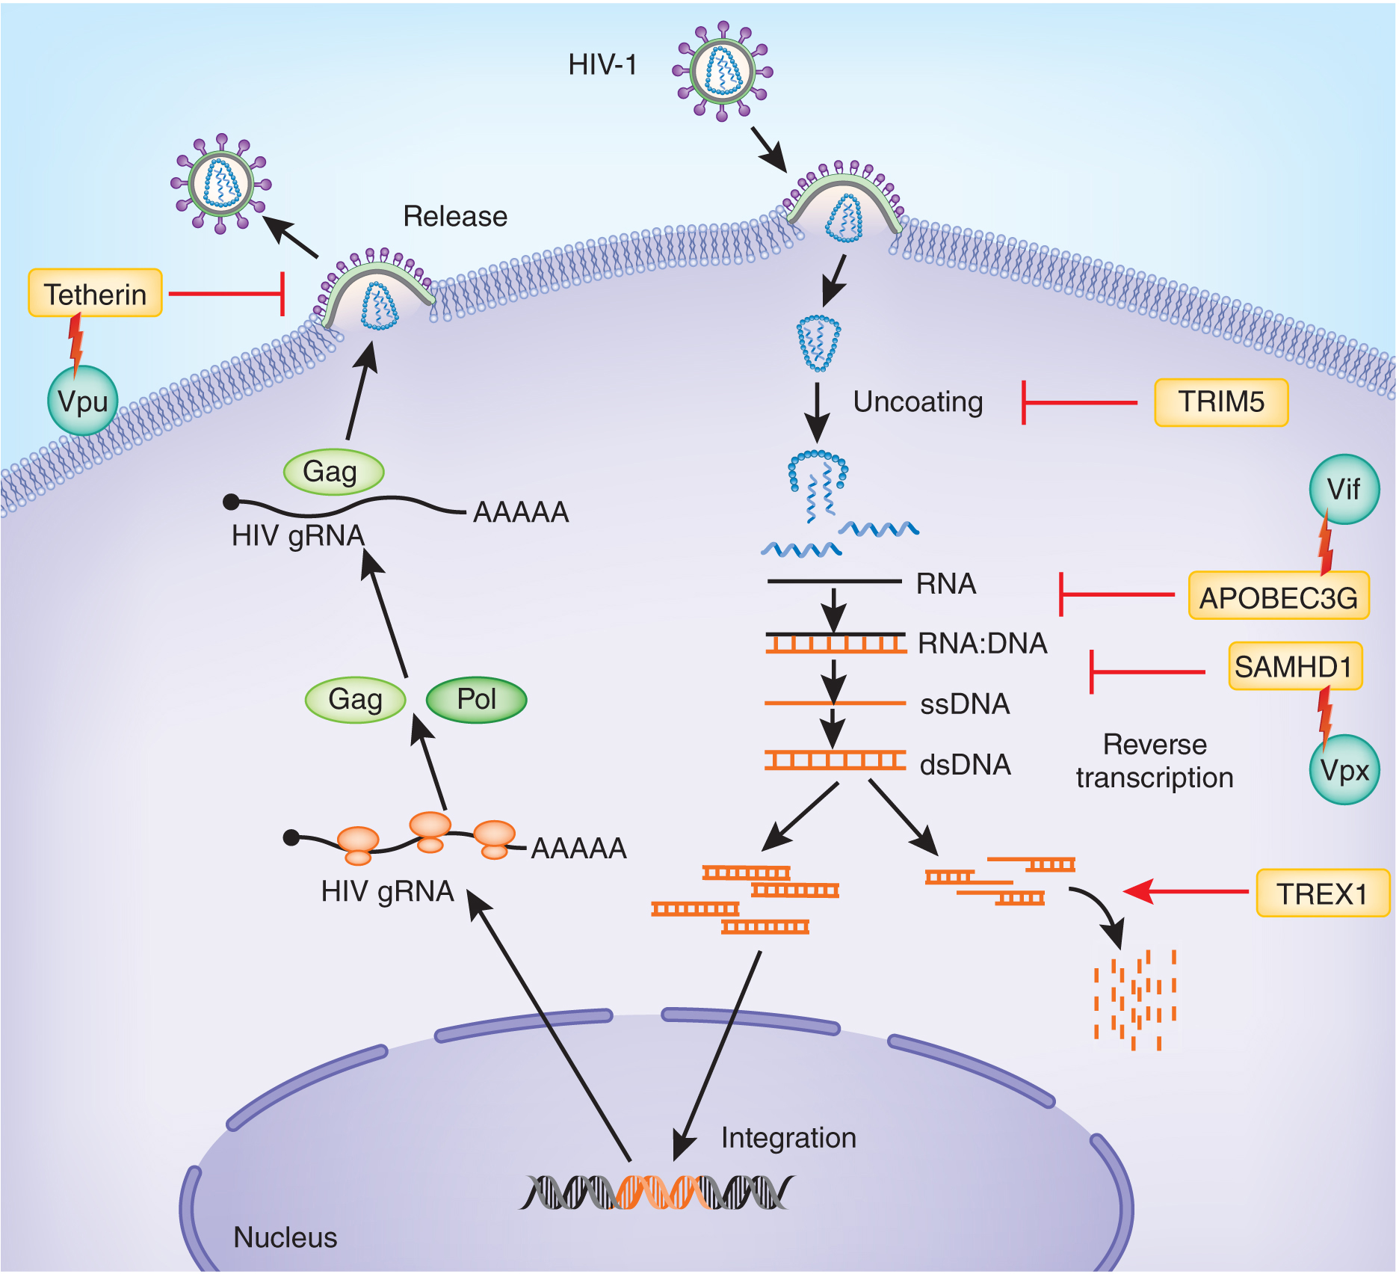
Intrinsic Antiviral Factors Against HIV-1

