Slide 1
Bacterial Warfare: Secretion / Sensing Danger

Slide 2
Secretion and Translocation systems
Sec-dependent pathway
  the major pathway for all bacteria for transporting proteins across the inner membrane
  Types I – Type VII systems
  cross the outer membrane
all pathways require energy

Slide 3
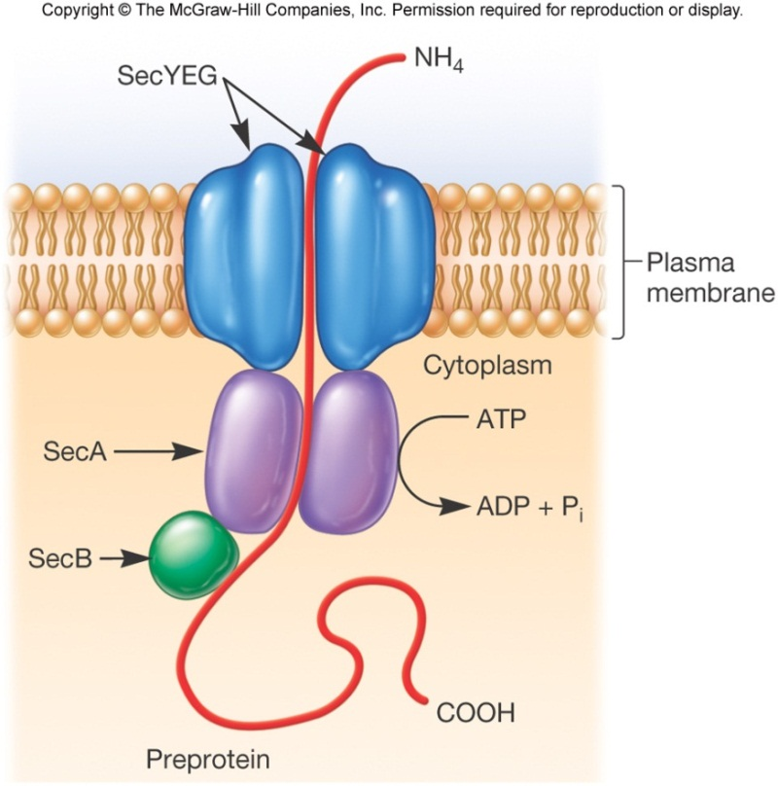
Sec system
https://www.youtube.com/watch?v=ukUdSZhA8m4
Found in all three domains of life. Unfolded proteins transported across or into
the membrane. N-terminal signal peptides recognized by chaperones (SecB),
and cleaved in the periplasm

Slide 4
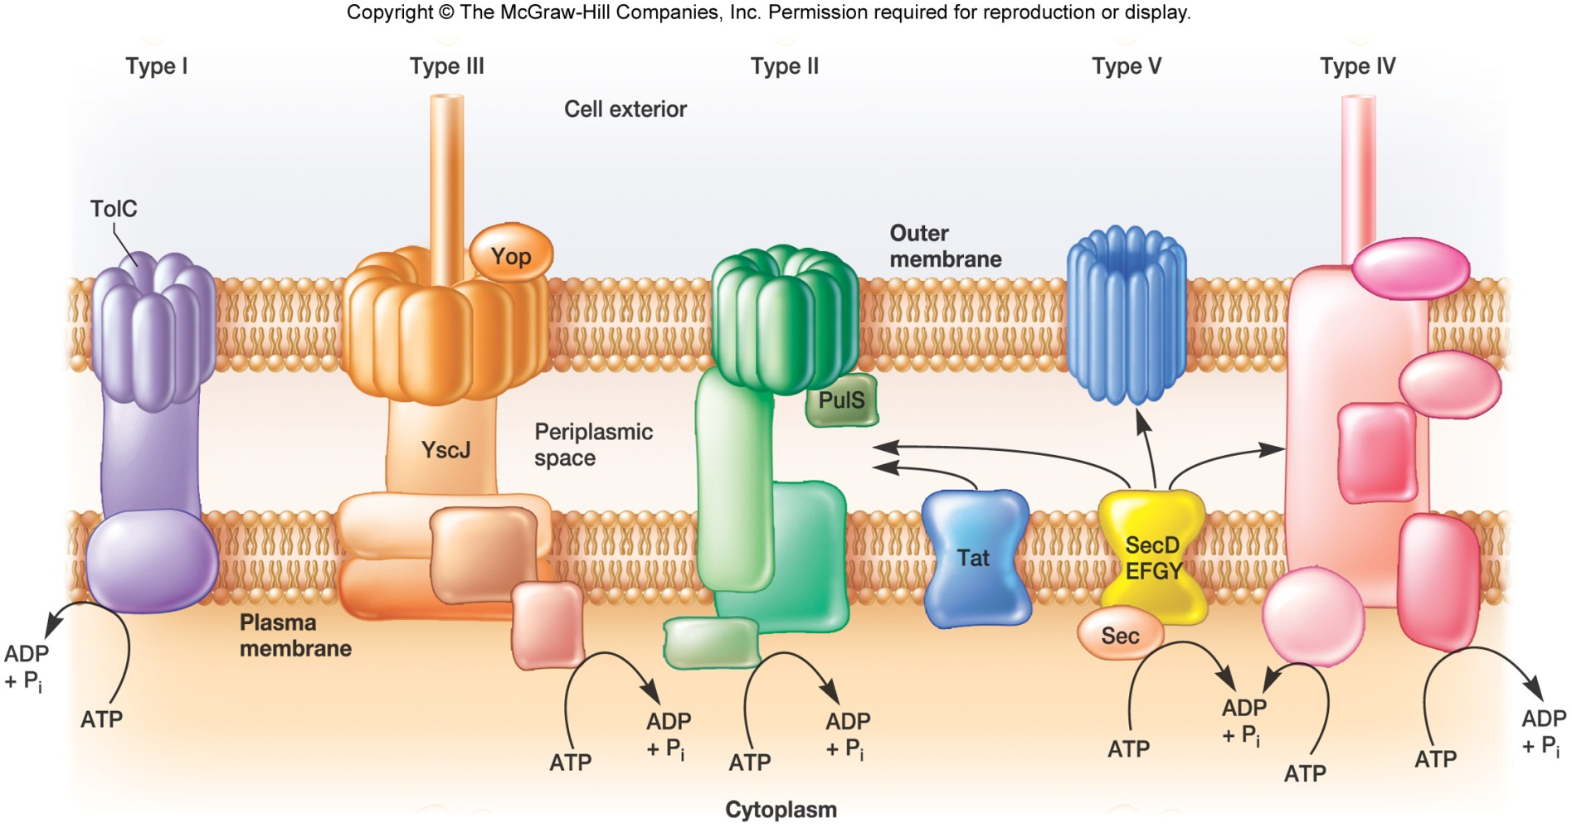
Secretion systems I – V and Tat
Inserting proteins in the outer membrane: β-barrel Bam complex
http://www.nature.com/nature/journal/v531/n7592/fig_tab/nature17199_SV2.html

Slide 5
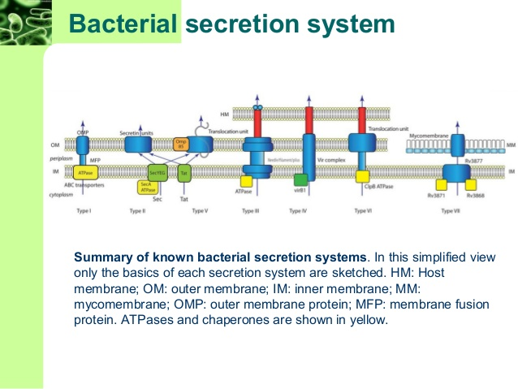

Slide 6
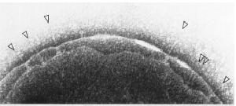
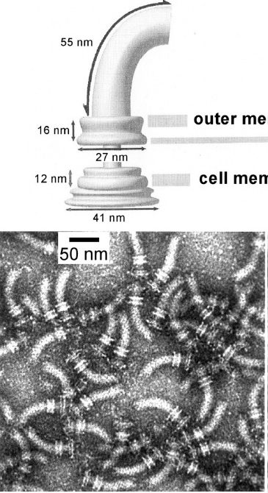
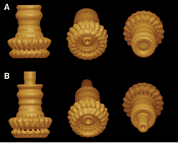
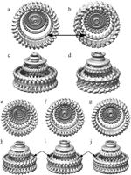
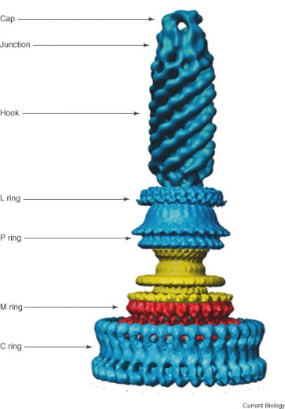
17 Å resolution structures of central components of
S. typhimurium needle & flagella HBB
SPI needles
Flagella
Salmonella typhimurium
Marlovitz et a., Science 2004
DeRosier, J. Bact. 2006

Slide 7
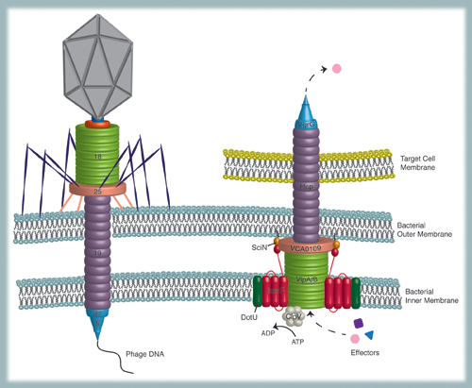
Type VI related to phage tail contractile machinery
Can kill bacterial as well as eukaryotic target host cells
Records, A. R. Mol Plant-Microbe Interac 2011

Slide 8
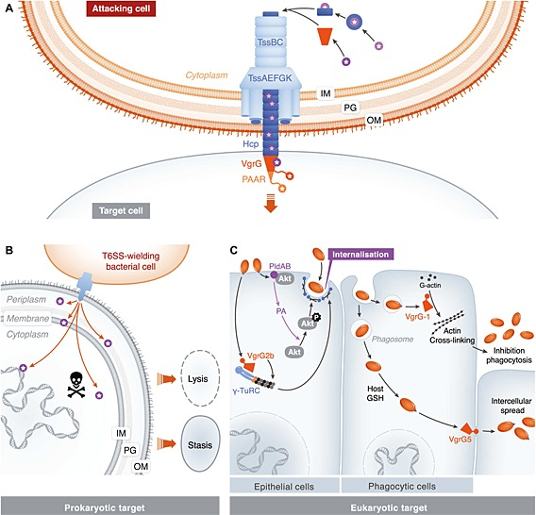
T6SS targeting pro- and eukaryotic cells
V. Cholerae & P. aeruginosa
Diniz et al., Cell Microbiol. 2015

Slide 9
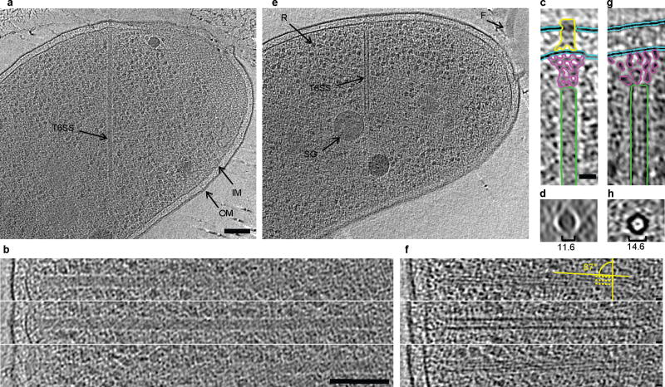
Electron cryotomographic imaging of T6SS structures inside intact V. cholerae cells
Basler et al. 2012

Slide 10
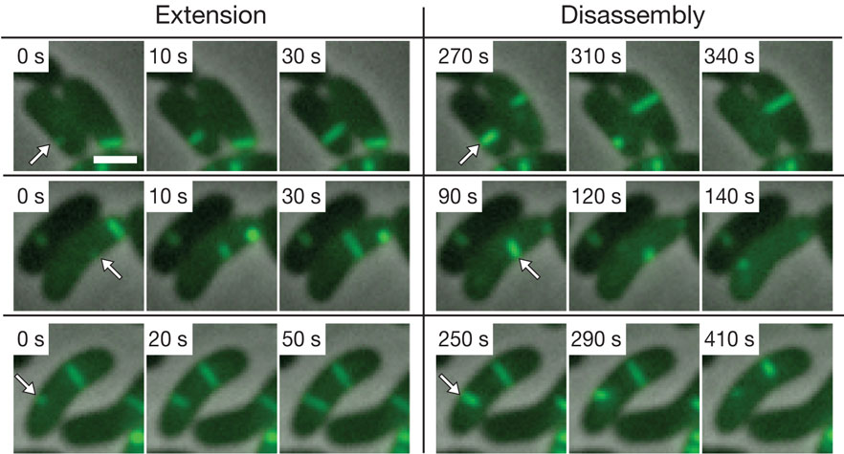
Type VI nano-weapon visualized by VipA-GFP fusion
Vibrio cholera
Basler_Mekalanos, Nature 2012

Slide 11
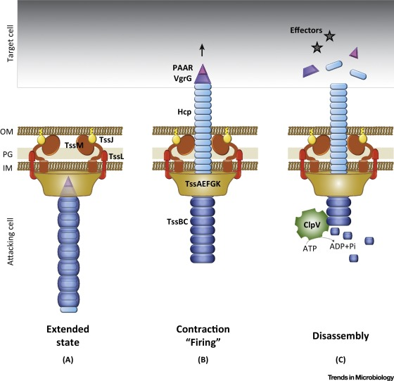
Signals: sensing danger?
Basler et al, Cell, 2013
Base plate
Contraction of the sheath provides the energy to translocate proteins out of effector cells and into adjacent target cells
Cianfanelli et al., TIM 2016

Slide 12
Marine Tubeworm Metamorphosis Induced by Arrays of Bacterial Phage Tail–Like Structures
Many benthic marine animal populations are established and maintained by free-swimming larvae that recognize cues from surface-bound bacteria to settle and metamorphose. Larvae of the tubeworm Hydroides elegans, an important biofouling agent, require contact with surface-bound bacteria to undergo metamorphosis; however, the mechanisms that underpin this microbially mediated developmental transition have been enigmatic. Here, we show that a marine bacterium, Pseudoalteromonas luteoviolacea, produces arrays of phage tail–like structures that trigger metamorphosis of H. elegans. These arrays comprise about 100 contractile structures with outward-facing baseplates, linked by tail fibers and a dynamic hexagonal net. Not only do these arrays suggest a novel form of bacterium-animal interaction, they provide an entry point to understanding how marine biofilms can trigger animal development.
Shikuma et al. Science, 2014

Slide 13
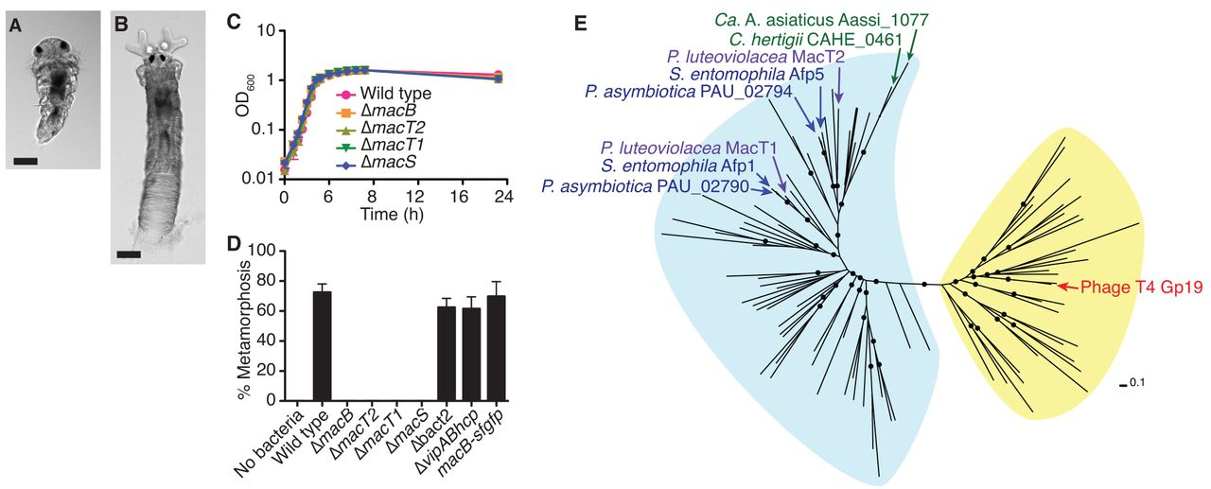
Marine tubeworm Hydroides elegans recognizes cues from surface-bound bacterial
biofilms to settle and metamorphose
Larva
Adult
Grant Jensen & Co. Science, 2014
Mac: the metamorphosis-associated contractile structure

Slide 14
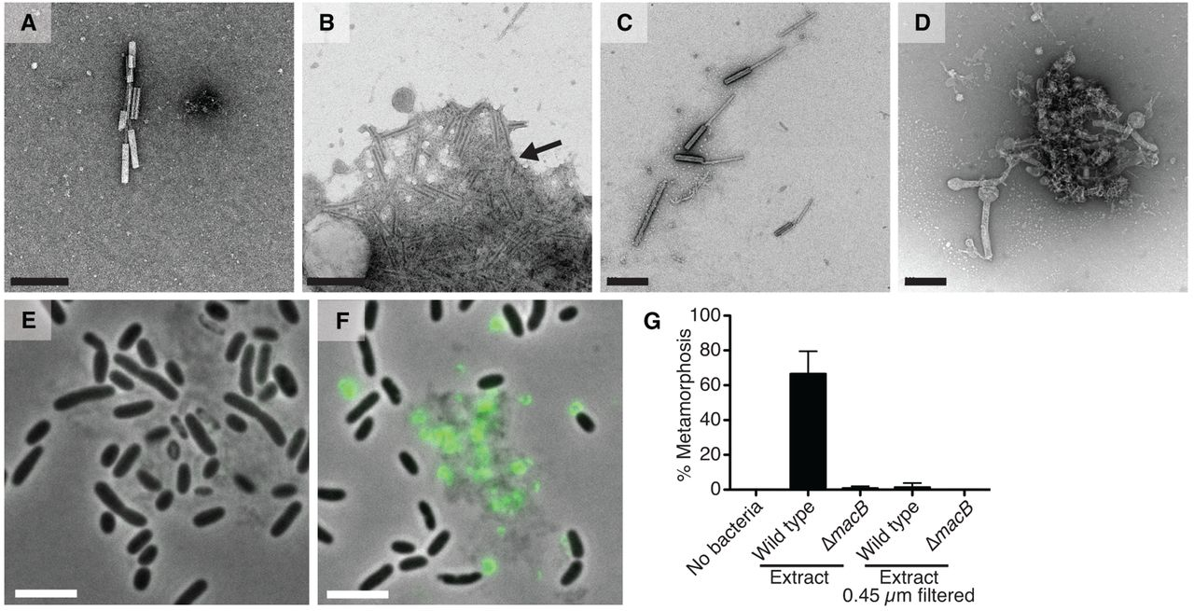
MACs are phage tail-like structures, are released by cell lysis and mediate metamorphosis of H. elegans
Movie S1

Slide 15
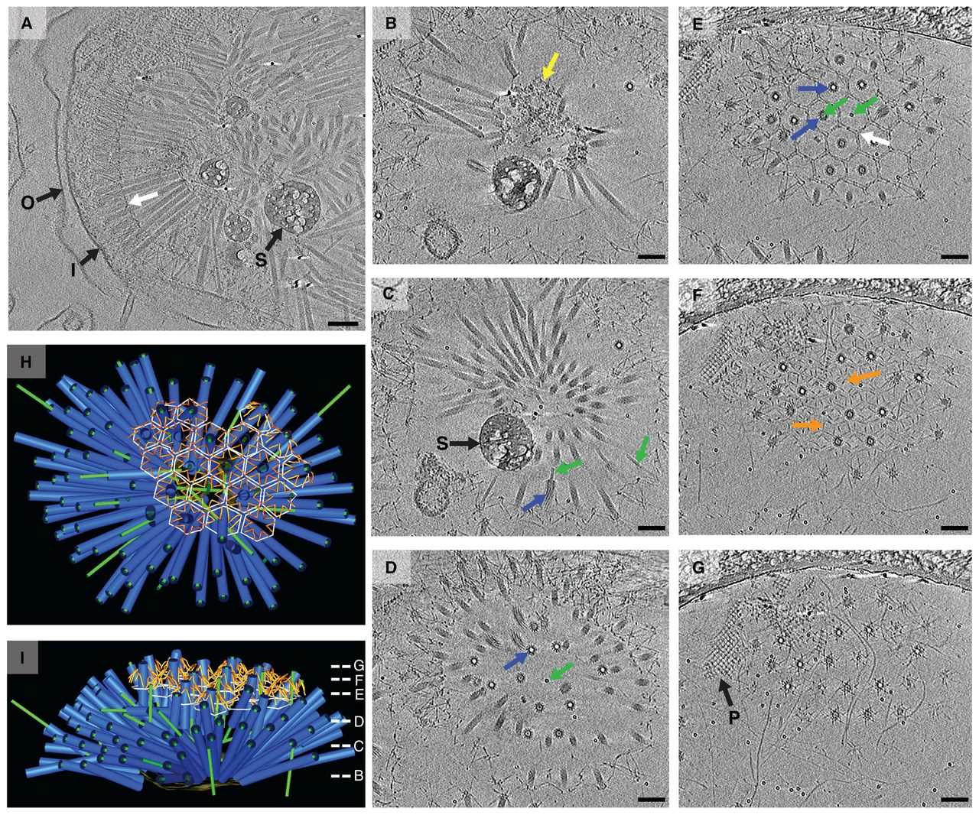
MACs are assembled intracellularly and expand as an ordered array upon cell lysis
Movie S2

Slide 16
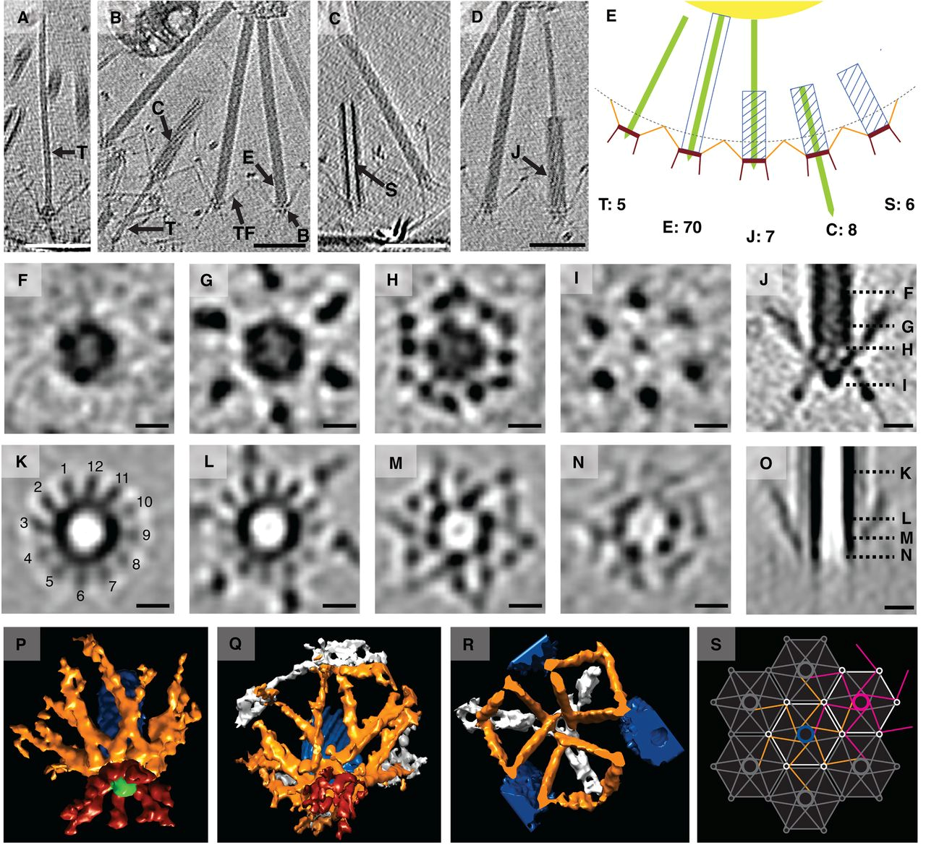
MACs are observed in different functional states and connected by tail fibers
Fire cooperatively?

Slide 17
The evolutionary pressure to produce MACs is probably strong, given that MAC production leads to the lysis and death of a subpopulation of cells. Whether this represents an instance of altruistic behavior that facilitates group selection, or a neutral lytic event with a set frequency remains to be determined. Although MAC production is beneficial for tubeworm larvae by inducing metamorphosis, it is currently unclear how larval settlement and metamorphosis might benefit the bacterium. It is equally possible that MACs evolved for a completely different purpose.
Grant Jensen & Co. Science, 2014

Slide 18
Review

Slide 19
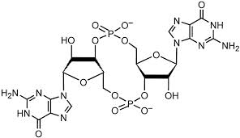
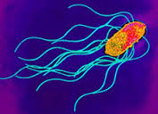
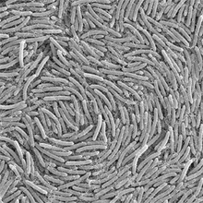
c-di-GMP
Stick or Swim
Motility
Biofilms
19

Slide 20
REC
PAS
GAF
HAMP
GGDEF
EAL
HD-GYP
2 GTP
2 GMP
Diguanylate cyclase
DGC
Phosphodiesterase
PDE
Effectors
Proteins / RNA
Target

Slide 21
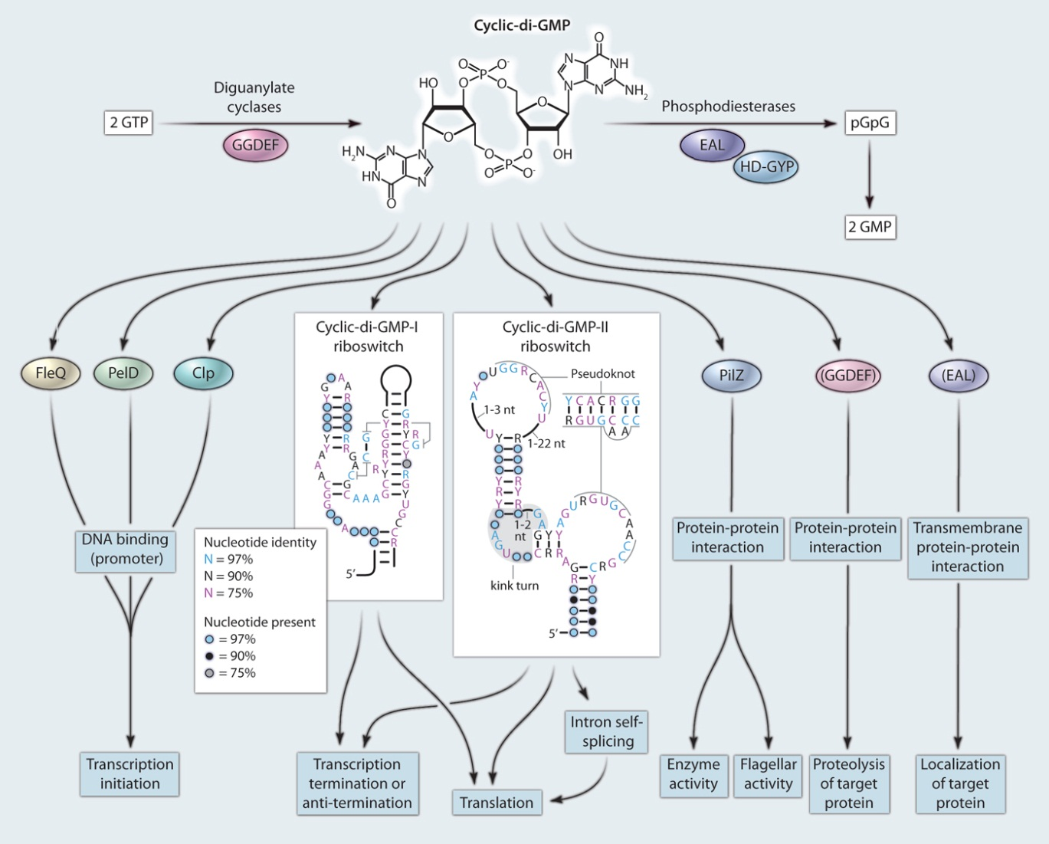
c-di-GMP effectors and effects
YhjH
Effector
YcgR
Target
Hengge R, Sci Signal, 2010

Slide 22
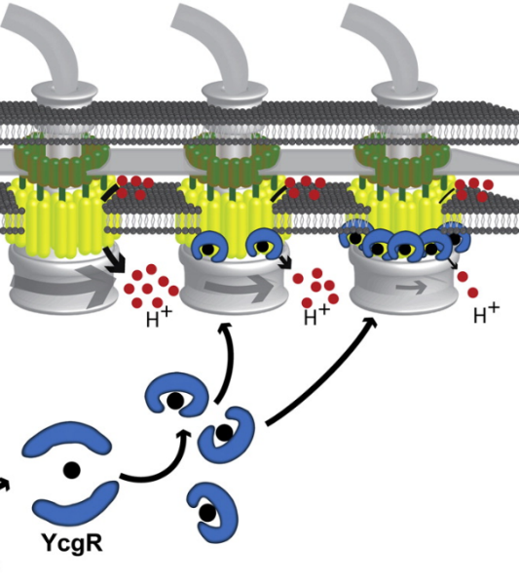
Two models for how speed is reduced by YcgR::c-di-GMP
Blair-Harshey model
YcgRc binds to FliM and skews bias, while disrupting FliG-MotA interactions to act as brake
YcgRc disrupts FliG-MotA interaction
Jenal model

Slide 23
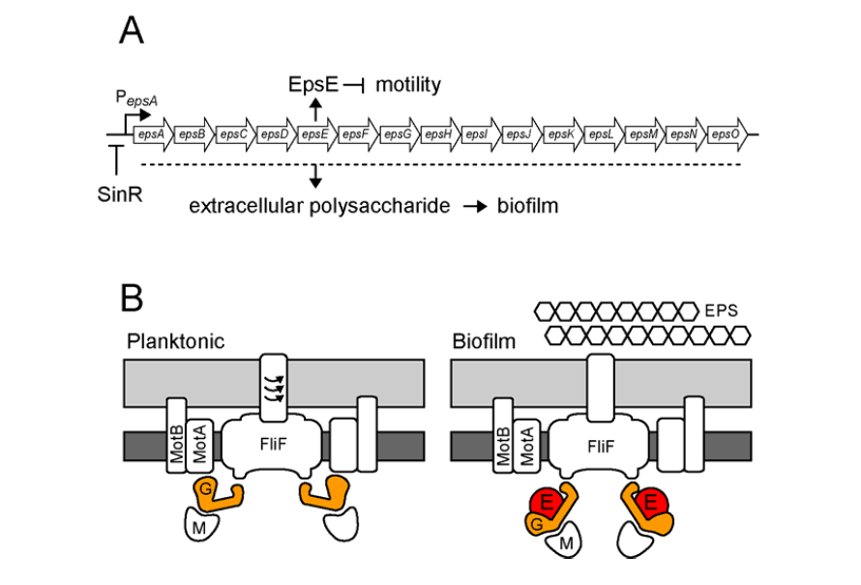
Model: EpsE acts as a clutch
A. SinR governs the alternate regulation of motility and biofilm formation by inhibiting
expression of the eps operon. During biofilm formation, the operon expresses both the
biofilm matrix and EpsE, a motility inhibitor.
B. EpsE disrupts FliG-MotA interaction.

Slide 24
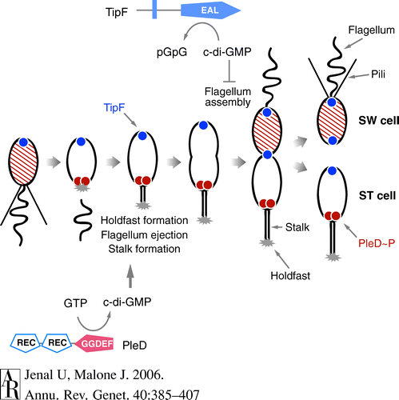
PleD~P in response to surface signals generates c-di-GMP
in Caulobacter to promote holdfast formation
Surface attachment/
Slow motor are signals
RR
DivJ and PleC are polar
Kinases involved in
phosphorylation of PleD
Gain of motility in swimmer cells requires low ci-di-GMP

Slide 25
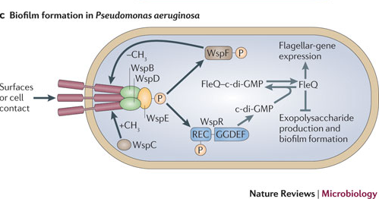
II. Wsp chemosensory pathway of Pseudomonas senses surface signals
to make c-di-GMP : Biofilms
The Wsp chemosensory pathway is homologous to the chemosensory system in E. coli, except it suppresses motility and promotes biofilm formation. In this model, WspE kinase activity is activated via signal-dependent conformational changes in the WspA/WspB or WspA/WspD complex. WspE phosphorylates WspR. FleQ activates flagella expression and represses EPS expression. C-di-GMP inactivates FleQ, relieving inhibition of exopolysaccharide synthesis.
Adaptation to external signals is mediated by the phosphorylation-dependent methylesterase activity of WspF and the methyltransferase WspC.

Slide 26
Dual role for guanyl cyclase YfiN
DGCs
BcsA
YcgR

Slide 27
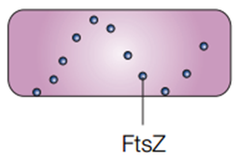
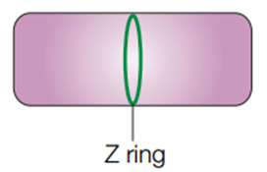
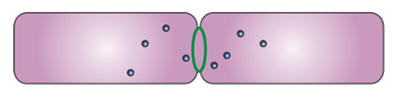
YfiN prevents division septum formation
YfiN

Slide 28
YfiN is a bifunctional protein: DGC & division inhibitor

Slide 29
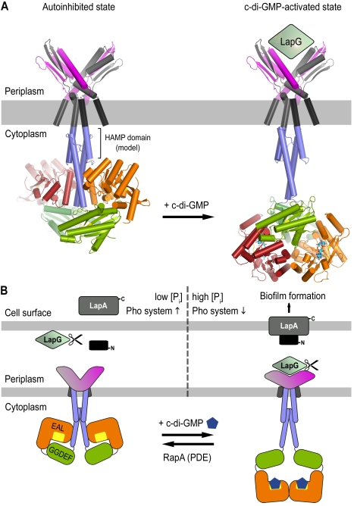
Inside-Out signaling mechanism
Conformational changes in the intracellular domain of LapD regulates the conformation of its periplasmic output domain, which differentially interacts with a protease, LapG, that in turn controls the stability of the cell surface LapA adhesin, and hence biofilm formation. LapG is
sequestered when LapD is activated, allowing LapA to anchor in the OM

Slide 30
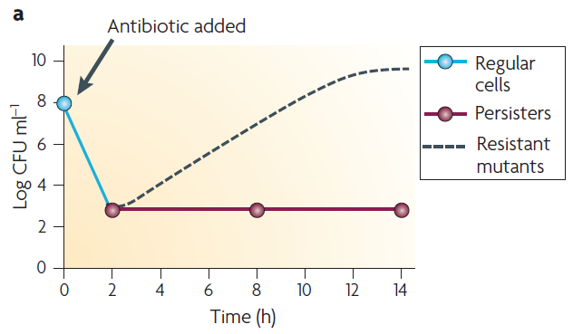
Persiters: Resistance versus tolerance

Slide 31
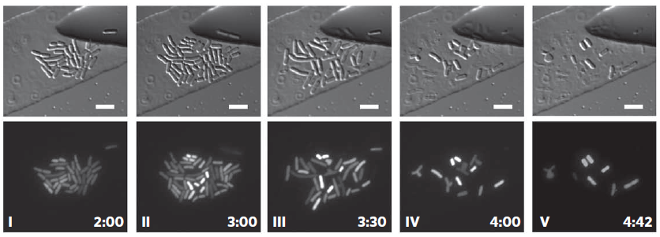
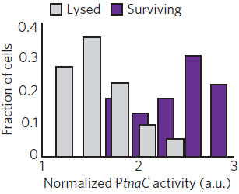
Direct observation of indole-induced persisters
<microfluidic chemostat>
Time
(hr)
+ indole
+ Amp

Slide 32
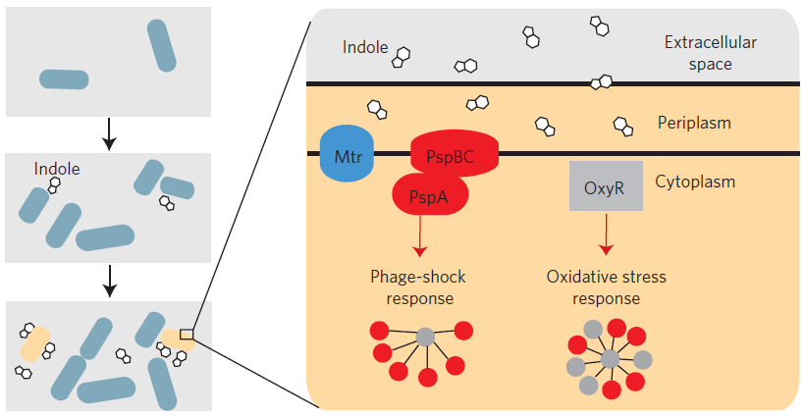
Indole-induced persister formation

Slide 33
Good luck!

