Slide 1
Bacterial Magnesium Sensing and TCS Specificity

Slide 2
Two-component systems regulate diverse responses including
a) nutrient acquisition : nitrogen, phosphorus, carbon
b) energy metabolism : electron transport systems, uptake and catabolic machinery
c) adaptation to physical or chemical aspects of the environment : chemotaxis, pH, Mg osmolarity, light quality
d) complex developmental pathways: sporulation, fruiting body development, swarmer cell production
e) virulence : plasmid transfer (conjugation), degradative secretions, toxin production
f) Quorum sensing: light production, secretion of degradative enzymes, surfactants

Slide 3
TC genes and the Environment
The number of TC genes appears to correlate strongly with ecological and environmental niches. Bacteria that live primarily in constant environments typically encode relatively few two-component signaling genes. In the extreme, many obligate intracellular parasites and endosymbionts harbor only a few pathways or sometimes none at all, as with Mycoplasma and Amoebophilus.
By contrast, bacteria that inhabit rapidly changing or diverse environments typically encode large numbers of these signaling proteins. Extreme cases include Myxococcus xanthus, with 136 histidine kinases and 127 response regulators.
These patterns of gene content strongly suggest that organisms expand their set of two-component signaling genes to adapt to fluctuations in their environment.

Slide 4
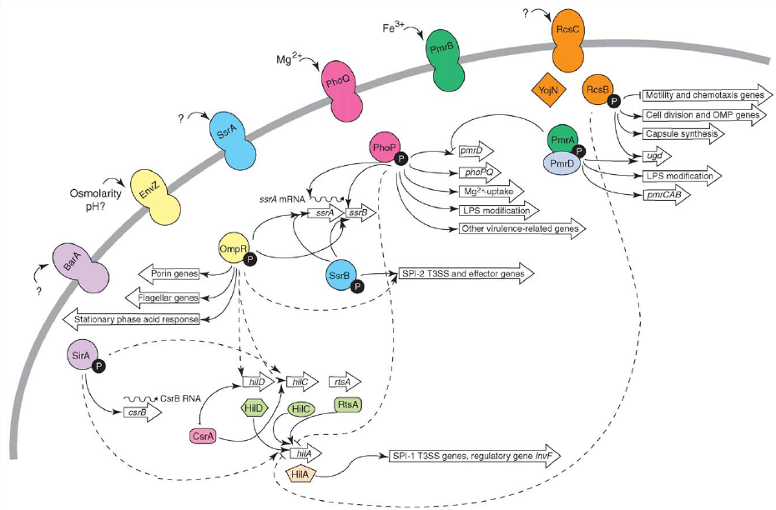
TCS systems controlling virulence gene expression in S. enterica
Beier and Gross 2006

Slide 5
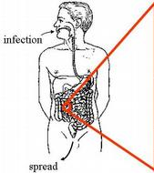
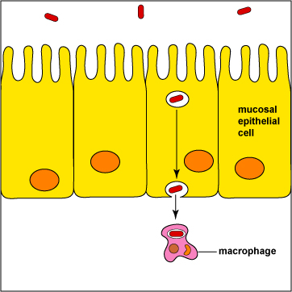
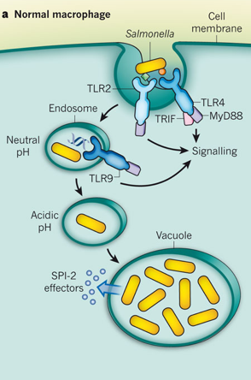
Salmonella typhimurium - pathogenesis
Spread to other cells/ Diarrhea

Slide 6
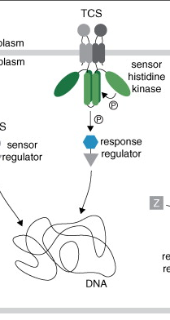
The PhoP/PhoQ TCS system senses Mg++
Extracellular milieu
High Mg²⁺ levels
Intracellular milieu
Low Mg²⁺ levels
PhoP/Q mutants are attenuated for virulence in mice

Slide 7
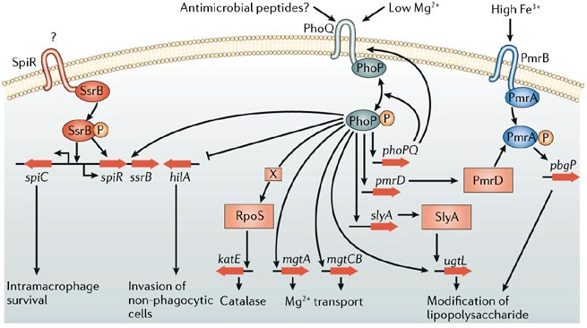
The Salmonella PhoP/PhoQ system governs adaptation to low Mg++
Acidic pH
PhoPQ governs the expression of > 100 genes in S. typhimurium !

Slide 8
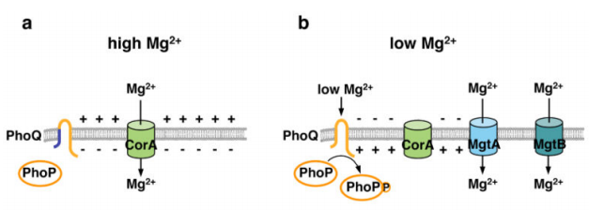
Low Mg²⁺ as a physiological signal inside macrophages:
Two mechanisms for Mg sensing
Groisman et al, 2014

Slide 9

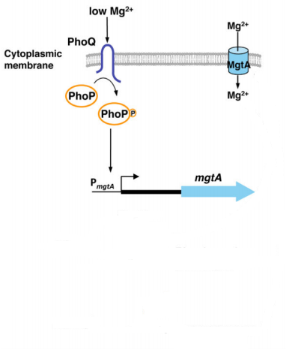

Slide 10
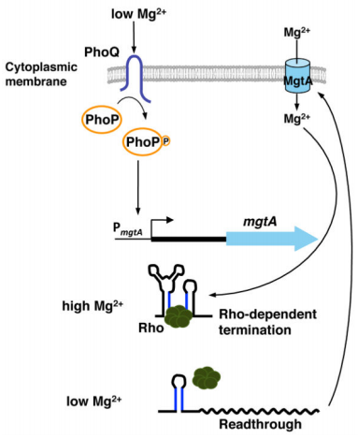
The 5’UTR of the mgtA gene can adopt different stem-loop structures depending on the Mg²⁺ levels
5’ UTR
Full length mRNA

Slide 11
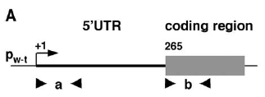
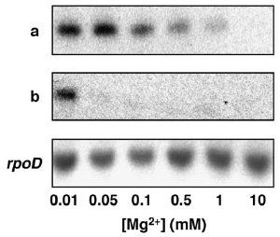
The 5’UTR and Coding Regions of the mgtA mRNA are
differentially regulated by Mg²⁺
mRNA
Primer
Sets (a/b)
Monitor the mgtA mRNA levels of Salmonella that had been grown in different Mg2+ concentrations by conducting reverse transcription PCR (RT-PCR) with different sets of primers
a) first 100 nucleotides of the 5’UTR
b) first 100 nucleotides of the coding region

Slide 12
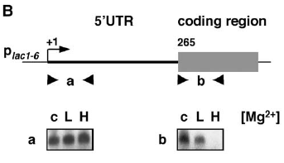
The 5’UTR and Coding Regions of the mgtA mRNA are
differentially regulated by Mg²⁺
mRNA
Primer
Sets (a/b)
The wild-type mgtA promoter was replaced by a derivative of the lac promoter that does not respond to Mg2+.
→ The mgtA transcription elongation responds to Mg2+.

Slide 13
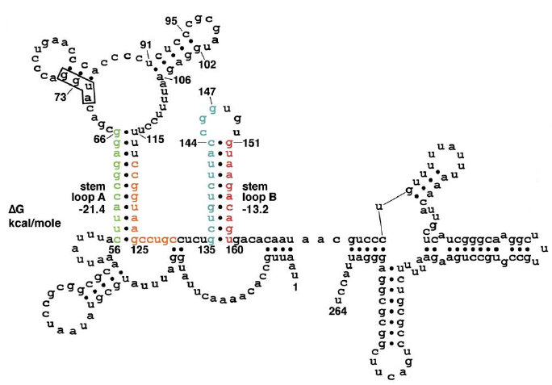
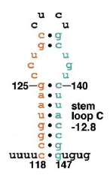
The phylogenetically conserved structure of the 5’UTR of mgtA suggests a possible regulatory mechanism
1) Stem A and B
or 2) Stem C
Using computational analysis, two potential stem-loop structures that might be adopted by the mgtA 5’UTR were predicted.

Slide 14


The phylogenetically conserved structure of the 5’UTR of mgtA suggests a possible regulatory mechanism
1) Stem A and B
or 2) Stem C
- Under this scenario, the mgtA 5’UTR might adopt different structures (i.e., stem loops A plus B versus C), which would be determined by the cytoplasmic Mg2+ levels, and result in transcription stopping within the 5’UTR or proceeding into the mgtA coding region.

Slide 15
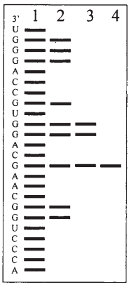
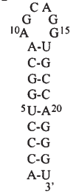
Mg2+ modifies the structure of the mgtA 5’UTR
How to probe RNA secondary structures?
→ Use RNase T1, an enzyme that cleaves unpaired G residues in RNA.
EXAMPLE
5’ end-labeled RNA molecule
→ Treat with RNase T1 and load on gel

Slide 16
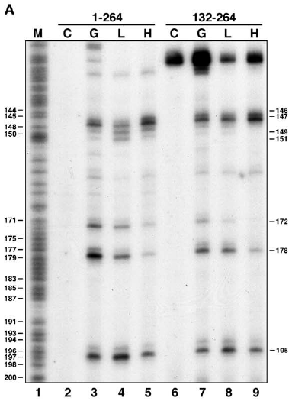
Mg2+ modifies the structure of the mgtA 5’UTR
Low /High Mg2+
Substrate: 5’ UTR (1-264) synthesized in vitro
Enzyme: RNase T1 cutting unpaired G residues
G146/147
G151

Slide 17
Mg2+ modifies the structure of the mgtA 5’UTR
Low /High Mg2+
unpaired
Substrate: 5’ UTR (1-264) synthesized in vitro
Enzyme: RNase T1 cutting unpaired G residues
G146/147
G146/147
G146/147 → cleaved in A+B
cleaved in high Mg2+
In high Mg2+ → stem A+B
paired

Slide 18
Mg2+ modifies the structure of the mgtA 5’UTR
Low /High Mg2+
Substrate: 5’ UTR (1-264) synthesized in vitro
Enzyme: RNase T1 cutting unpaired G residues
paired
G151
G151
G151 → cleaved in C
cleaved in low Mg2+
In low Mg2+ → stem C
unpaired

Slide 19

High Mg2+
Low Mg2+
1) Stem A and B
2) Stem C
Transcription
terminated
Full-length mRNA
No more MgtA
MgtA (Mg2+ transporter) ↑
Further mutagenesis experiments showed that Stem A+B stops transcription elongation while Stem C allows read-through.

Slide 20
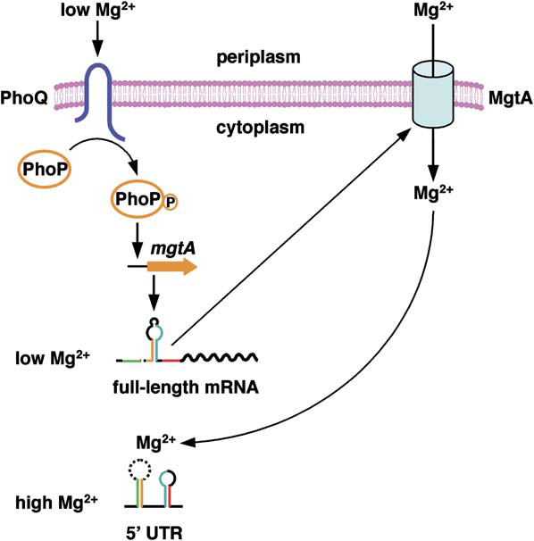
Expression of the Mg2+ transporter MgtA is regulated in two distinct steps
The initiation of mgtA transcription is regulated by PhoPQ in response to extracellular Mg2+
The elongation of mgtA transcription is regulated by distinct stem-loop structures of 5’UTR in response to cytoplasmic Mg2+

Slide 21
Why the expression of MgtA is controlled by both cytoplasmic and extracytoplasmic Mg2+
Environmental changes in macrophage
Acidic pH
→ to exert differential control over the Mg2+ transporter gene versus those genes that play other roles

Slide 22
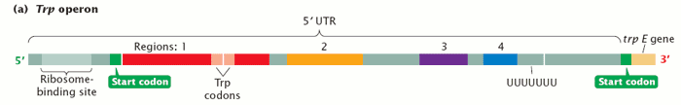
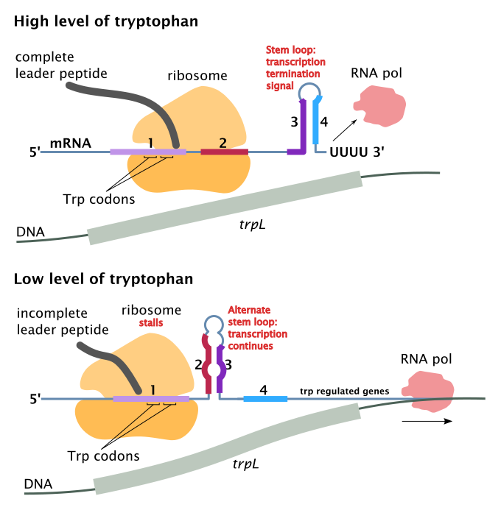
Another example of attenuation (premature termination of transcription): Tryptophan biosynthesis regulon
What is the difference between the trp operon and the mgtA gene regulation?
→ The trp operon responds to different molecules (tryptophan and tRNA^{Trp}) in the same compartment (the cytoplasm).

Slide 23

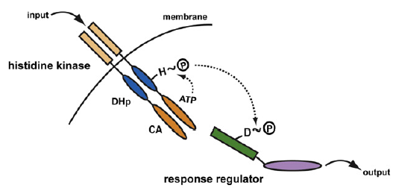
Histidine kinase
CA: Catalytic ATP-binding domain
DHp: Dimerization and Histidine phosphotransfer domain
Response regulator
RD: Receiver domain

Slide 24
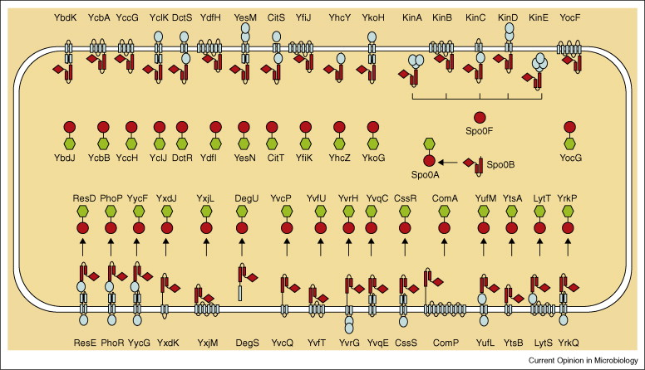
Exquisite specificity of TCS
29 TCS pathways in B. subtilis: no cross-talk
66 TCS pathways in E. coli: no cross-talk

Slide 25
Co-variance can determine interaction specificity
As a consequence of gene amplification in the same cell, the unique function of each two-component system requires that evolution maintain strict monogamous interactions between protein partners. This necessitates that the partner proteins interact in the same way regardless of the signaling pathway. These constraints confine the evolutionary choices of amino acid changes in both partners at any position in the interaction surface. Limited choices are revealed as high-covariance positions between partners in statistical analyses of large two-component system databases

Slide 26
Exquisite specificity of TCS
Histidine Kinase
Response Regulator
EnvZ
DHp
CA
RD
OmpR
CC1181
DHp
CA
RD
CC1182
RstB
DHp
CA
RD
RstA
→ Which domain/residues are determining the specificity?

Slide 27
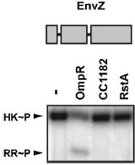
Analysis of domain-level chimeric histidine kinases
Histidine Kinase
Response Regulator
EnvZ
DHp
CA
RD
OmpR
RD
CC1182
RD
RstA

Slide 28
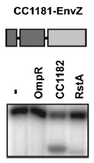

Analysis of domain-level chimeric histidine kinases
Histidine Kinase; chimeras
Response Regulator
CC1181-EnvZ
DHp
CA
RD
OmpR
RD
CC1182
RD
RstA

Slide 29
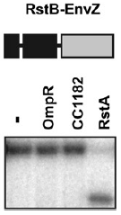
Analysis of domain-level chimeric histidine kinases
Histidine Kinase; chimeras
Response Regulator
RstB -EnvZ
DHp
CA
RD
OmpR
RD
CC1182
RD
RstA

Slide 30
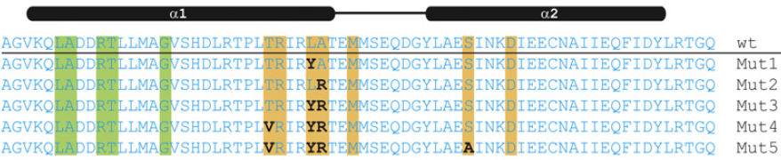
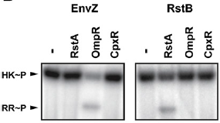
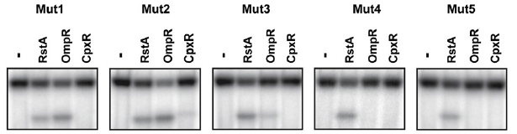
Rewiring two-component signal transduction pathways
EnvZ
DHp
CA
→ Changing as few as three residues is sufficient to change the substrate preference of EnvZ to that of RstB.

Slide 31
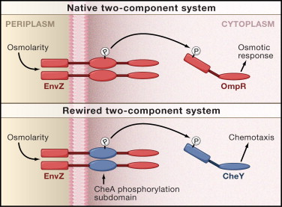
Rewiring a bacterial TCS: synthetic biology
Kohanski & Collins, Cell 2008
A method for reprogramming protein-protein interactions
“For example, reprogramming a two-component sensor to activate the chemotaxis response
regulator could be used to induce the swarming of bacteria toward a stimulus of interest. The
bacteria could then be further engineered to execute a specific task once they arrive at the
region of interest. For example, they can be programmed to encase the area in a biofilm or to
produce a compound to degrade an unwanted substance in the local environment. “

Slide 32
TCS pathways as drug targets
Whereas two-component genes are found in yeasts, filamentous fungi, slime molds, and plants, they are conspicuously absent from higher eukaryotes and metazoans. The absence of two-component signaling proteins from humans, combined with their well-documented role in bacterial pathogenesis, has made these proteins attractive new targets for antibiotic development.

