Slide 1
Indole signaling, biofilms and persisters

Slide 2
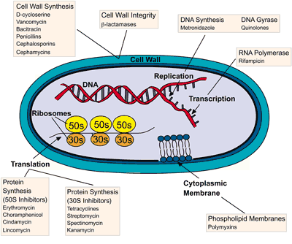
Resistance
<antibiotics and their action mechanisms>

Slide 3
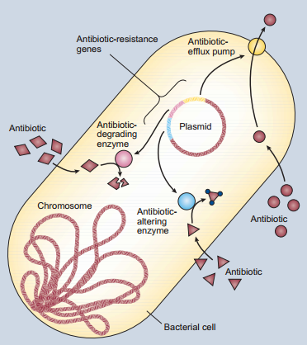
Plasmid-borne resistance
<Bacterial antibiotic resistance>

Slide 4
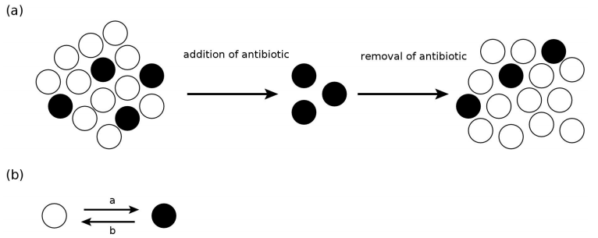
Bacterial persistence
chronic / recurrent infections
Persisters
: slow-growing
Bacterial persistence is a state in which a subpopulation of cells survives antibiotic or other stressors.

Slide 5
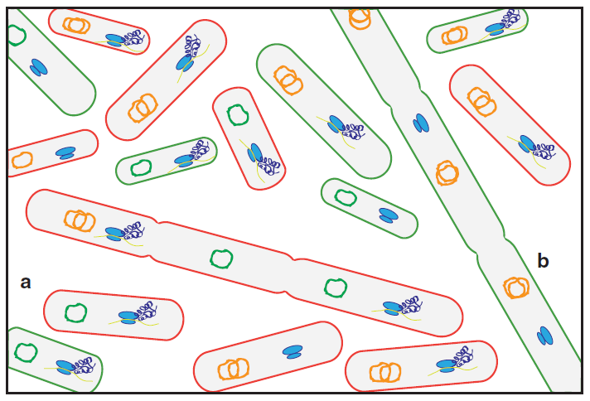
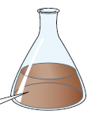
Bacterial heterogeneity
Within a group of persisters, there may be significant diversity based on multiple, tolerance-conferring mechanisms. Membrane potential can be active (red) or reduced (green). DNA may be under active replication (orange circles) or not (green
cicrles). Ribosomes (in blue) may be translating proteins or inhibited. Cell division is blocked in some cells. For example, cell a has normal translation, high membrane potential, but inhibited DNA synthesis, whereas cell b has inhibited translation, low membrane potential, active DNA replication, and stalled cell division.

Slide 6
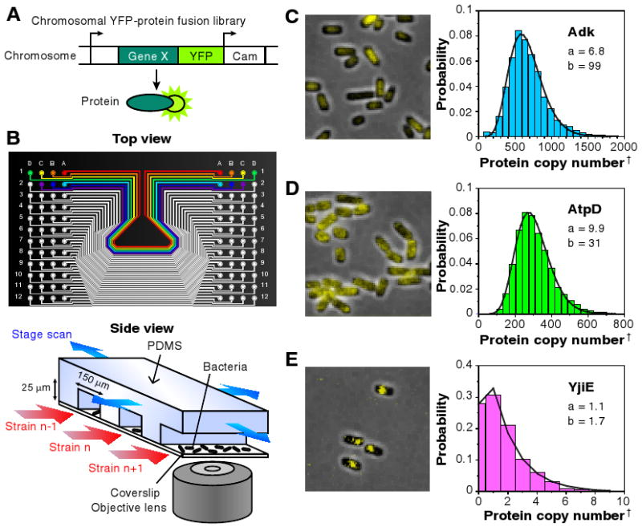
Quantifying E. coli proteome (and transcriptome) with single-molecule sensitivity in single cells: levels vary widely
Quantitative imaging of a YFP-fusion library. (A) Each library strain has a yellow fluorescent protein (YFP) translationally fused to the C-terminus of a protein in its native chromosomal position. (B) A poly-dimethylsiloxane (PDMS) microfluidic chip is used for imaging 96 library strains. E. coli cells of each strain are injected into separate lanes and immobilized on a polylysine-coated coverslip for automated fluorescence imaging with single molecule sensitivity. (C-E) Representative fluorescence images overlaid on phase contrast images of three library strains, with respective single cell protein level histograms
Taniguchi et. Al. 2010

Slide 7
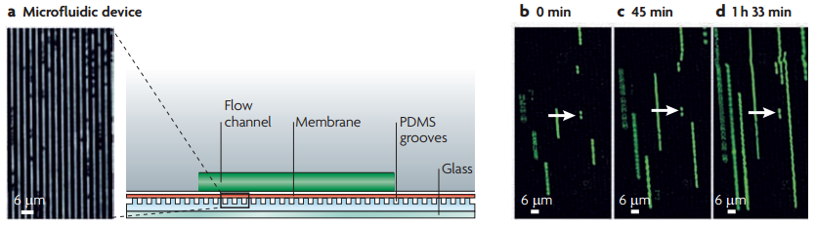
Persister cells
- Persisters pre-exist in the population and are slow-growing cells.

Slide 8
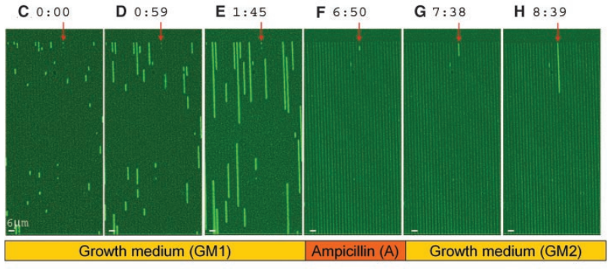
Persister cells
- Persisters pre-exist in the population and are slow-growing cells.

Slide 9
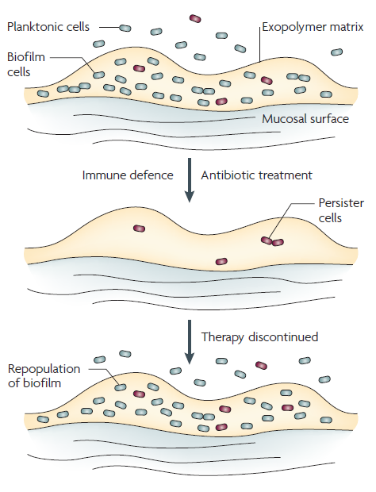
Biofilms and persisters
Biofilm infections
highly recalcitrant to antibiotic treatment.
result in chronic infections.

Slide 10
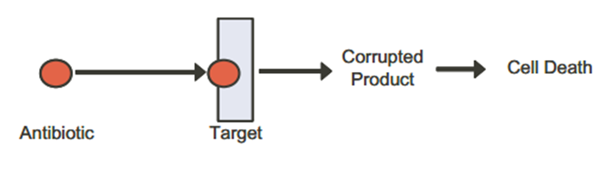
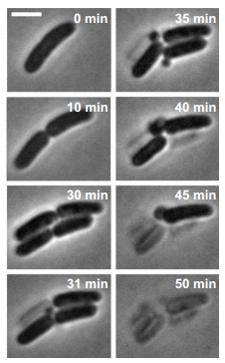
Resistance versus tolerance
(unstable cell wall)
(cell lysis)
(Ampicillin)
(PBPs; cell wall synthetic enzymes)
< example; ampicillin >
PBPs
Cell wall
synthesis
Ampicillin
; cell wall synthesis inhibitor

Slide 11
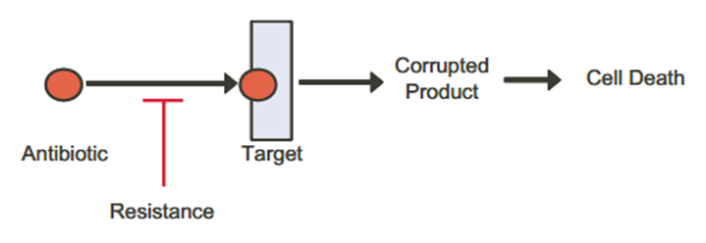
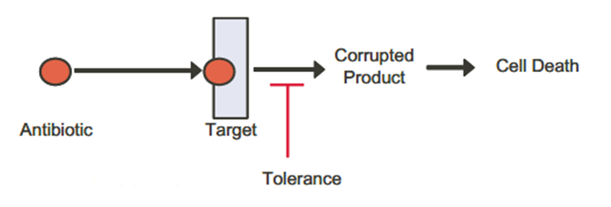
Resistance versus tolerance

Slide 12
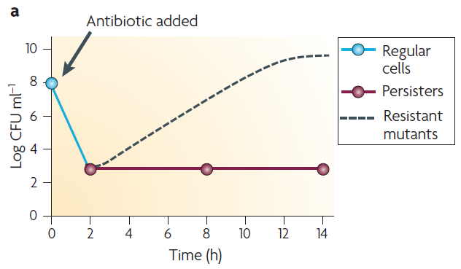
Resistance versus tolerance

Slide 13
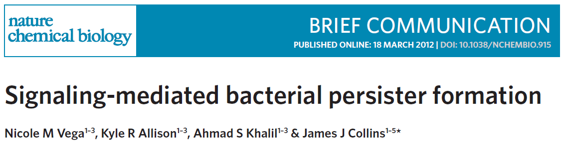
- Indole signaling and persister formation

Slide 14
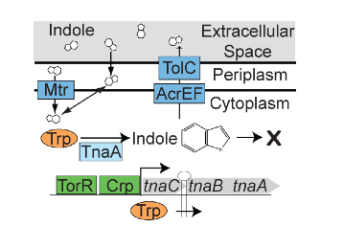
Metabolism of the signal molecule indole

Slide 15
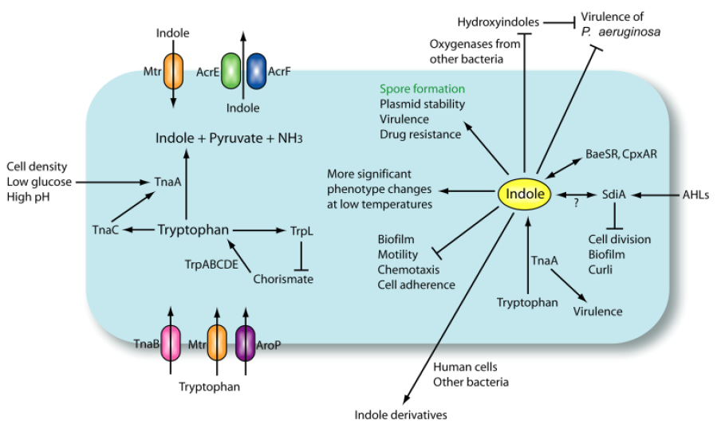
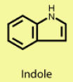
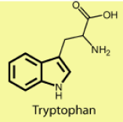
Indole signaling

Slide 16
Indole signaling and persistence
Conditions
for indole production
Conditions
for persister formation
Slow-growing
Stationary phase
Nutrient limitation
SOS response (DNA damage)
HYPOTHESIS: Indole signaling may trigger the formation of bacterial persisters.
how to test this hypothesis?

Slide 17
Indole signaling and persistence
w/ indole
Cells in
Trp-free medium
+ antibiotic treatments
Survival rates?
w/o indole
HYPOTHESIS: Indole signaling may trigger the formation of bacterial persisters.

Slide 18
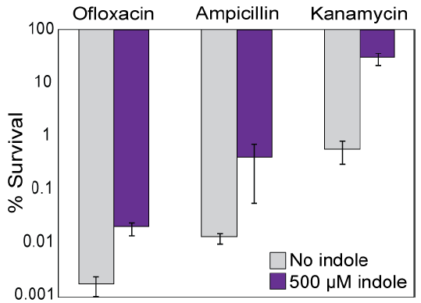
Indole signaling and persistence
HYPOTHESIS: Indole signaling may trigger the formation of bacterial persisters.
to test this hypothesis:
Incubation with indole increases persistence and the effects are non-specific.

Slide 19
Suggest a genetic experiment

Slide 20

Indole signaling and persistence
In Trp-free medium
wild-type
+ antibiotic treatment
Survival rates?
∆tnaA
HYPOTHESIS: Indole signaling may trigger the formation of bacterial persisters.
to test this hypothesis?

Slide 21
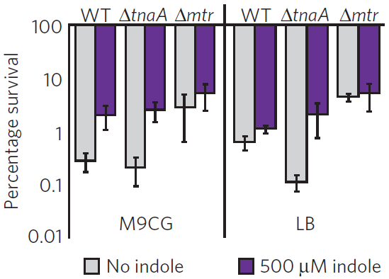
Indole signaling and persistence
WT makes very little indole in M9 but much more in LB; Δtna is deficient.
Persisters not eliminated in Δtna, suggesting additional mechanisms.
Blocking transport (Δmtr) increased persisters in WT; adding indole had no effect.

Slide 22
Indole signaling and persistence
→ The ∆tnaA mutation decreases persister formation.

Slide 23

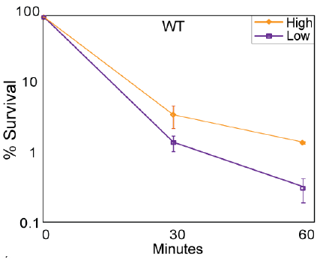
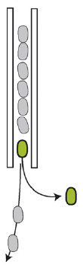
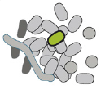
Direct observation of indole-induced persisters
<fluorescence-activated cell sorting (FACS)>
Monitor indole response by using the fluorescent reporter plasmid PtnaC.
tnaC promoter
GFP
indole-responsive
High and Low = fluorescence
FACS:
Mixed culture
Further analysis; survival in ofloxacin

Slide 24
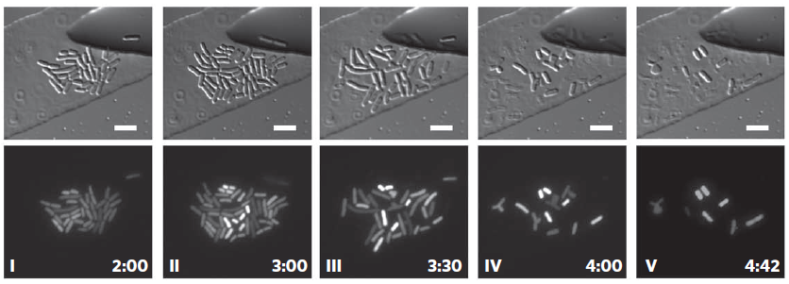
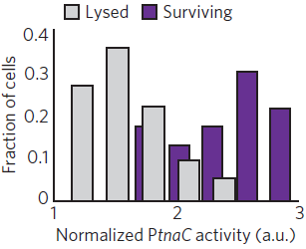
Direct observation of indole-induced persisters
<microfluidic chemostat>
Time
(hr)
+ indole
+ Amp

Slide 25
Transcription response to indole signaling
- Examine the genome-wide transcriptional response to indole using microarrays.
Cells
w/o indole
Cells
w/ indole
RNA extraction
mRNA
mRNA
Compare the expression profiles

Slide 26
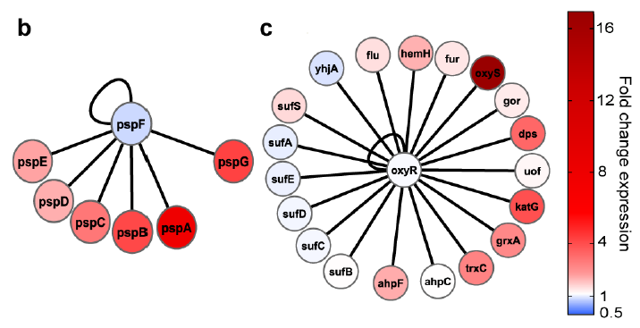
Effects of indole signaling
- Examine the genome-wide transcriptional response to indole using microarrays.
Phage-shock response
Oxidative stress response
(extracytoplasmic stress)

Slide 27
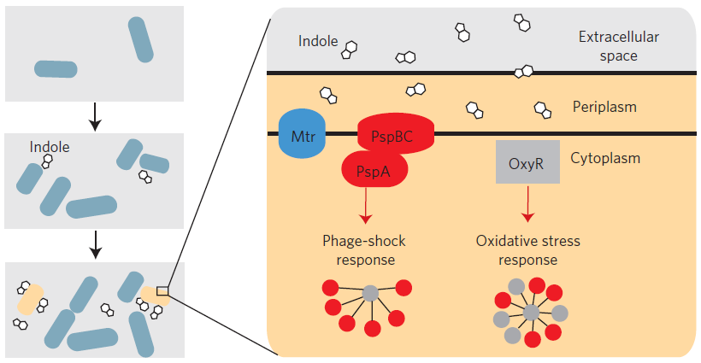
Indole-induced persister formation

Slide 28
Persistence in non-specific

Slide 29
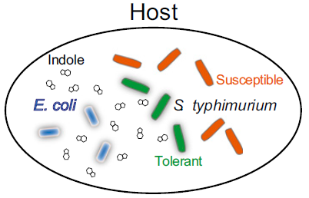
Indole and inter-species communication
(commensal)
(pathogenic)
- The intestinal pathogen Salmonella typhimurium increases its antibiotic tolerance
in response to indole, even though S. typhimurium does not natively produce indole.
- S. typhimurium can intercept indole signaling from the commensal bacterium E. coli to enhance its antibiotic tolerance in the host intestine.
Vega et al. (2013) PNAS

Slide 30
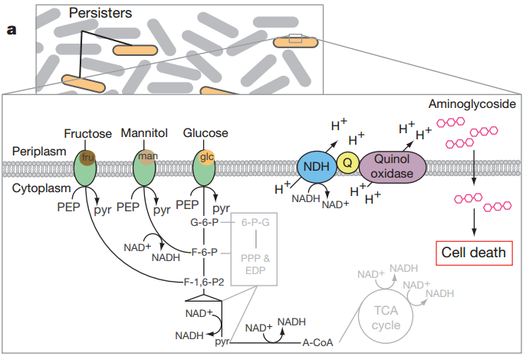
How to eradicate persisters?
< example – aminoglycoside treatment >
Uptake of aminoglycoside requires the PMF(proton motive force) that is generated by NADH.
Dormant cells
that stop making NADH
→ tolerant to aminoglycosides.
Allison et al. (2012) Nature

Slide 31
How to eradicate persisters: Metabolic stimulation
Uptake of aminoglycoside requires the PMF(proton motive force) that is generated by NADH.
metabolic stimuli
→ NADH production
Allison et al. (2012) Nature

Slide 32
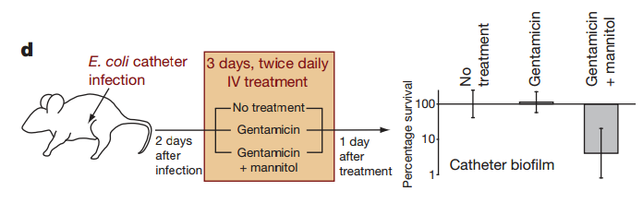
How to eradicate persisters: Metabolic stimulation
Allison et al. (2012) Nature

